Slide 1

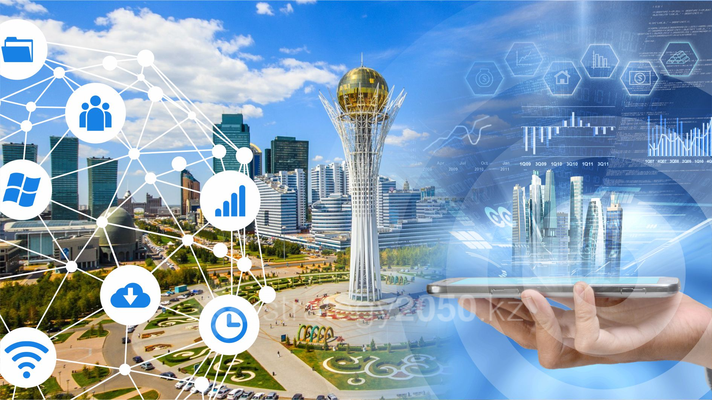
SMART TECHNOLOGY

Slide 2
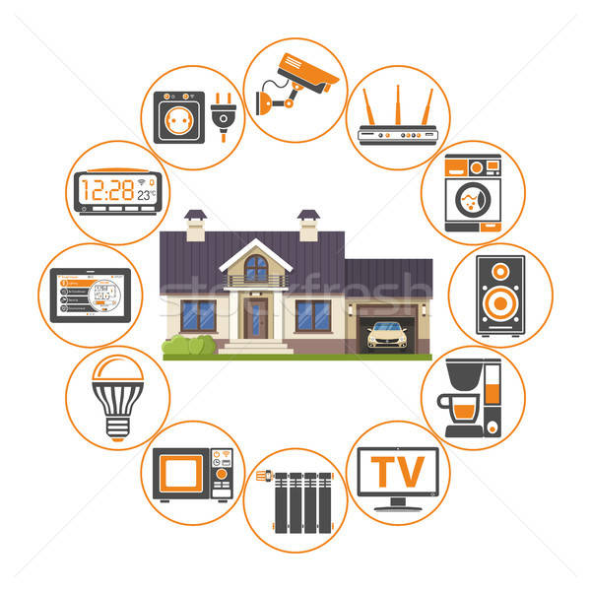
Smart: What does it really mean?
The ‘smart’ tag is being applied to an increasing number of products and services. But what does is really mean?
The true meaning of the word ‘smart’ is likely to be an electronic device or system that can be connected to the internet, used interactively, and is to some extent intelligent.

Slide 3
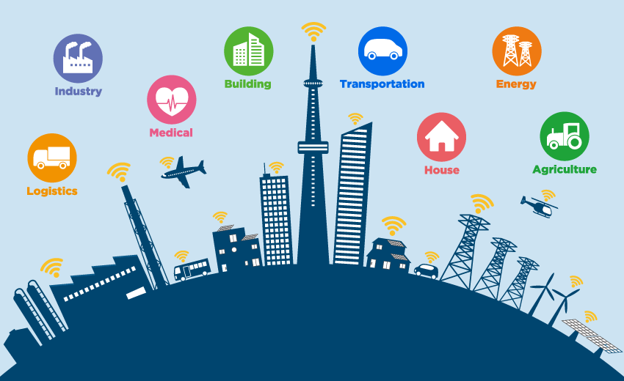
Smart: What does it really mean?
Internet of things (Internet of things, IoT) is a certain concept of the computer network of physical objects («things»), which are equipped with built-in technologies to interact with each other or external environment. «Smart houses», smartphones, tablets and almost any «things» can serve as an example of such a concept. These «things» are equipped with sensors: cars, industrial equipment, jet engines, oil derricks, wearable devices and much more. All these «things» collect data and exchange them with each other.

Slide 4
SMART TECHNOLOGY

Slide 5


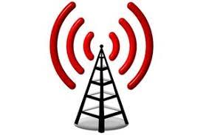
SMART TECHNOLOGY
This concept is associated with the development of two technologies:
radio frequency identification (RFID)
RFID (Radio Frequency Identification) – a method of automatic identification of objects in which by means of radio signals the data stored in so-called transponders, or RFID-marks are read or registered. This technology is well suited for tracking the movement of certain objects and obtaining a small amount of information from them.
A wireless sensor network is a distributed, self-organizing network of a plurality of sensors (sensors) and actuators interconnected by a radio channel. In addition, the coverage area of such a network can be from several meters to several kilometers due to the ability to relay messages from one element to another. This technology is used to solve many practical problems related to monitoring, management, logistics, etc.
wireless touch
networks (WSN)

Slide 6
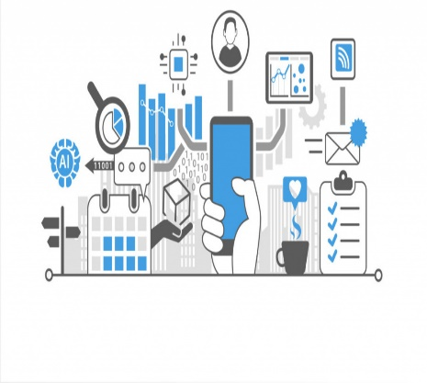
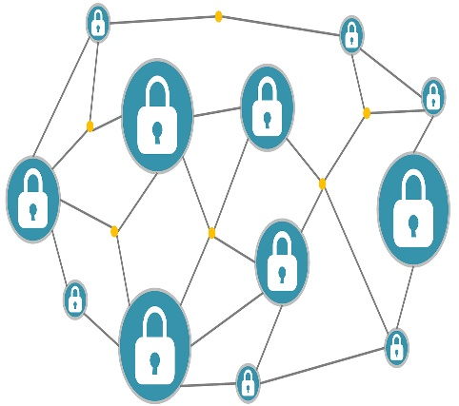
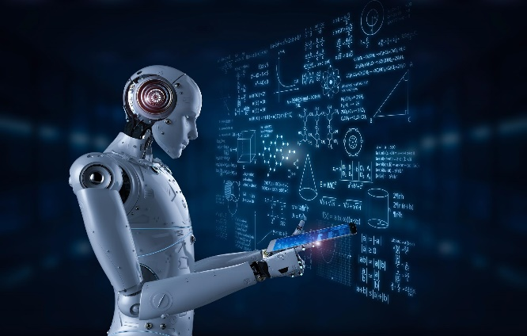
SMART TECHNOLOGY
Big data
Blockchain
Artificial intelligence

Slide 7
Blockchain
Blockchain is a technology of distributed storage of information, which concerns any vital questions.
The construction of Blockchain chain is based on three main principles:
distribution
openness
protection

Slide 8
Artificial intelligence
Artificial intelligence is one of the sections of informatics, within the framework of which the problems of hardware and software modeling are posed and solved. These problems concern those types of human activity that are traditionally considered intellectual (creative).
In researches on artificial intelligence, it is possible to determine two main directions:
1) Software-pragmatic - is engaged in the creation of programs with the help of which it is possible to solve those problems, the solution of which was previously considered to be exclusively prerogative of a person. This includes recognizing and game programs, programs for solving logical problems, searching, classifying, etc. This direction is focused on finding algorithms for solving intellectual problems on existing computer models.
2) Bionic - deals with the problems of artificial reproduction of those structures and processes that are characteristic for the living human brain and which are at the base of solving human problems. Within the framework of the bionic approach to the problem of artificial intelligence, a new science of neuroinformatics was formed, the practical output of which was the development of a neurocomputer, sixth generation computers.

Slide 9
‘smart’ products and technologies. Here are some examples grouped by their technological capabilities and innovations
Wirelessly connected | Interactive | Predictive | Innovative ideas (that use the term ‘smart’)
Smart TV | Smart table | Smart hard drive | Smart wi-fi
Smart baby monitor | Smart board | Smart connected vehicles | Smart(internet connection) services
Smart phone | Smart response XE | Smart buildings | Smart glass
Smart wallet | Smart burglar alarm | Smart traffic light | Smart restart
Smart monitor sensor | Smart fridge | Smart shelf | Smart travel card
Smart smoke alarm | Smart Cooker | Smart grind | Smart wheelchair
Smart body analyzer | Smart light bulb | Smart farm | Zoopla smart search
Smart watch | Smart meter | Smart wig | Smart pajamas
Smart thermostat | Smart plug | Smart toilet | Smart vacuum cleaner

Slide 10
History
1968 German inventor Jurgen Dethloff along with Helmet Grotrupp filed a patent for using plastic as a carrier for microchips.
1970 Dr. Kuntaka Arimura of Japan filed the first and only patent on the smart card concept
1974 Roland Moreno of Francefiles the original patent for the IC card, later dubbed the ‘smart card’
1977 Three commercial manufacturers, Bull CP8, SGS Thomson, and Schlumberger began developing the IC card product
1979 Motorola developed first single chip Microcontroller for French Banking
1982 World’s first major IC card testing
1992 Nationwide prepaid card project started in Denmark
1999 Federal Government began f Federal employee smart card identification

Slide 11
Conclusion
It is a technology that uses artificial intelligence, machine learning, and big data analysis to provide cognitive awareness to objects that were in the past considered inanimate.
5 Benefits of Smart Technology
Some of the key benefits of using smart technology are as follows:
1) Convenience
2) Ensures Sustainability
3) Security
4) Efficiency
5) Saves Money and Time

Slide 12
Thanks for your attention

