Slide 1
«Nanotechnologies and Nanomaterials»
Lecturer: PhD doctor, senior lecturer, Tilek Kuanyshbekuly Kuanyshbekov

Slide 3
- Introduction
Raman spectroscopy is a fundamental method for studying characteristics of carbon nanostructures, the transverse size of crystals, the density of defects, and the quality of the graphene layer and is used to describe the quality of graphene in manufacturing processes since it is not destructive [1–24]. Basically, the Raman spectra of carbon and carbon nanomaterials are characterized by two main peaks, designated as G and D peaks near 1589 and 1351 cm−1. The G peak originates from stretching of sp2 bonded carbon, while the D peak is due to the breathing mode of the C6 hexagonal ring, typically observed in disordered sp2-bonded carbon. In the case of graphite and few-layered graphene nanostructures, the Raman spectra present three main peaks, D, G, and a 2D peak. The 2D peak around 2730 cm−1 represents the second order of the D band; however, unlike the D band, the 2D peak does not require the presence of defects to be observed in graphitic materials. Increase in FWHM and a decrease in intensity of the 2D peak indicate the high level of disorder in sp2 graphitic structures.

Slide 4
Characterization of FFLGN by Raman spectroscopy
The Raman spectra of FFLGN, like graphene, have G and D bands, the first order of scattering of the E_{2g} phonon of sp² carbon atoms, G, the band is reflected around 1580 cm⁻¹, and also occurs due to stretching the C–C bond in the basal plane, which is characteristic of all sp² hybridized carbon materials, and the D band appears in zone of 1200–1400 cm^{–1} and indicates a certain amount of disorder, defect (disorder) or edges in the carbon structure
D and G bands have certain differences compared to graphite and graphene. In FFLGN, the D band is wider and more intense, while the G band is suppressed and significantly broadened and sometimes slightly mixed to higher frequencies. This shift may be due to the doping effects, with the result that doping will affect the mixing of the G band.
D, G, and 2D Raman scattering bands are the basis for characterizing the reduced FFLGN and determining the density of defects.

Slide 5
Another issue in the Raman spectroscopy of FFLGN and reduced FFLGN is the change in spectra after reduction. The D-band in FFLGN is mainly due to chemical functionalization and the expanded quantity of sp³ C atoms, also structural defects inside the carbon skeleton.
As described above, the D band in graphene can be caused by structural defects or functional additions, as in FFLGN. Thus, by removing and adding functional groups, carbon integrity can be studied.

Slide 6
To use this ratio to quantify disorder, it is important to consider two defect modes. Since the disorder in the graphene lattice begins to increase with a low-density defect, the I_{D}/I_{G} ratio also increases at first.
To determine the relative content of defects in the sp² carbon lattice, the most convenient measure is the ratio between the intensities I_{D}/I_{G}. The I_{D}/I_{G} ratio in FFLGN is more than graphene or graphite, where the D-band is often indistinguishable from the background and the I_{D}/I_{G} is of the order of 0.01.
As well as in other works on the sizes of the sp² zones in FFLGN thin films and bulk FFLGN samples obtained by the Hammers method reaches up to 2.5–6 nm
With a further increase in the density of defects, ultimately lead to the loss of the carbon lattice, the I_{D}/I_{G} ratio begins to decrease due to nonlinear damping of all the peaks of Raman scattering when the material begins to turn into amorphous carbon
In consideration of this I_{D}/I_{G} dependence on the density of oxygen-containing functional groups, we expect significant changes in the Raman spectra depending on the oxidation.

Slide 7
In the low-density density mode, ID/IG can be approximated by an empirical formula linking the relation to the distance between two adjacent defects, La:
ID/IG = С (λ)/La2 (1)
where λ is the excitation wavelength of Raman scattering and C (λ) is an empirical parameter: C (λ) = 102 nm2 for the excitation wavelength λ = 514 nm [17]. For FFLGN, La determines the size of graphite regions (domains) surrounded by oxygen-containing functional groups.
For edge defects, another formula (2), the Tuinstra-Koenig ratio [14], is more appropriate:
ID/IG = С (λ)/La (2)
Here, C (λ) = (2.4 × 10-10 nm-3)×λ4 [15], and λ is the wavelength of the excitation of Raman scattering. How unlike low defect density, in the high-density-defect mode, the ID/IG ratio depends directly on the size of the graphite cluster [16, 17]:
ID/IG = С (λ)/La (3)
Here C '(514 nm) = 0.55 nm-2 [16, 17]. As a result, the ratio between the intensities of the Raman scattering bands can serve as an estimate of the defect density in FFLGN, as well as the La value of graphite sp2 hybridized carbon clusters surrounded by sp3 hybridized functionalized sites.

Slide 8
In consideration of this ID/IG dependence on the density of oxygen-containing functional groups, we expect significant changes in the Raman spectra depending on the oxidation. This was observed in experiments on oxidative etching on single and layered graphite substrates [18]: ID/IG increased with oxidation, which indicates a decrease in the size of graphite carbon zones.
Due to significant oxidation, at a certain time a number of defects in the graphite structure can reach an enriched point at which, due to the degradation of six-membered rings, the intensity D of the Raman band begins to decrease. At such high defect densities, the ID/IG ratio decreases with decreasing size of the graphite cluster according to (3).
The combination of ID/IG dependencies on the size of sp2-hybridized zones with low and high defect density modes provides a suitable theoretical explanation for the observed behavior and allows us to estimate that the size of the graphite zones of La decreases to ~ 1 nm during oxidation. As well as in other works on the sizes of the sp2 zones in FFLGN thin films and bulk FFLGN samples obtained by the Hammers method reaches up to 2.5–6 nm [19, 21].

Slide 9
In the reverse process, of the reduction FFLGN, the I_{D}/I_{G} ratio changes differently for different experiments with different reduction procedures. Some studies on the chemical reduction of FFLGN showed no difference in I_{D}/I_{G} [19, 20], implying that although the oxygen-containing groups were removed by reduction and the places of defects left by these groups were not cured. Other studies show a decrease in the I_{D}/I_{G} ratio, which indicates the elimination of defects through reduction [21–23], and there are works in which an increase in the I_{D}/I_{G} ratio [14–16] is considered.
This may result from an increase in the number of disorders in the system and an increase in the intensity of the D band due to the random nucleation of small sp² zones. A no monotonic trend in the I_{D}/I_{G} ratio was also observed for experiments with gradual chemical reduction: with the first intensity ratio, D/G was reduced and then increased [17]. This is due to the growth of the sp² zones during the initial reduction leading to a decrease in the I_{D}/I_{G} ratio, followed by the random formation of smaller sp² zones within the sp³ clusters, which increased the lattice disorder and the I_{D}/I_{G} ratio [16, 18-22].

Slide 10
Raman spectra
Figure 1 shows the Raman results of our graphite, G–GO, BAC, and BAC–GO samples, and, according to the shown spectra, there are distinctive features in the peak positions and shapes of the G, D, and 2D peaks, and the relative intensity (which are normalized from 0 to 1) of these peaks also varies significantly. According to the Raman spectra in graphite, G–GO, BAC, and BAC–GO samples, there is a G peak due to in-plane stretching between sp2 carbon atoms and a D band recognized as a disordered band due to structural defects, edge effects and dangling sp2 carbon bonds that break the symmetry.

Slide 11
Table 1. Functional groups of G–GO and BAC–GO according to UV and FTIR spectra.
Samples | Functional Groups
 | UV Spectra, λ, Wavelength (nm) |  | FTIR Spectra, Wavenumber (cm⁻¹)
 | 228 | 233 | 980 | 1054 | 1249 | 1585 | 1723 | 1420 | 3300
G–GO | presence of π-π* bond of aromatic ring in GO molecule and C=O bonds in epoxy and carbonyl groups |  | C-O-H and C=O bonds | C–O alkoxy bonds | C–O epoxy functional groups | C=C bonds of the aromatic ring | C=O bonds in carbonyl group and carboxyl groups | O-H
BAC–GO

Slide 12
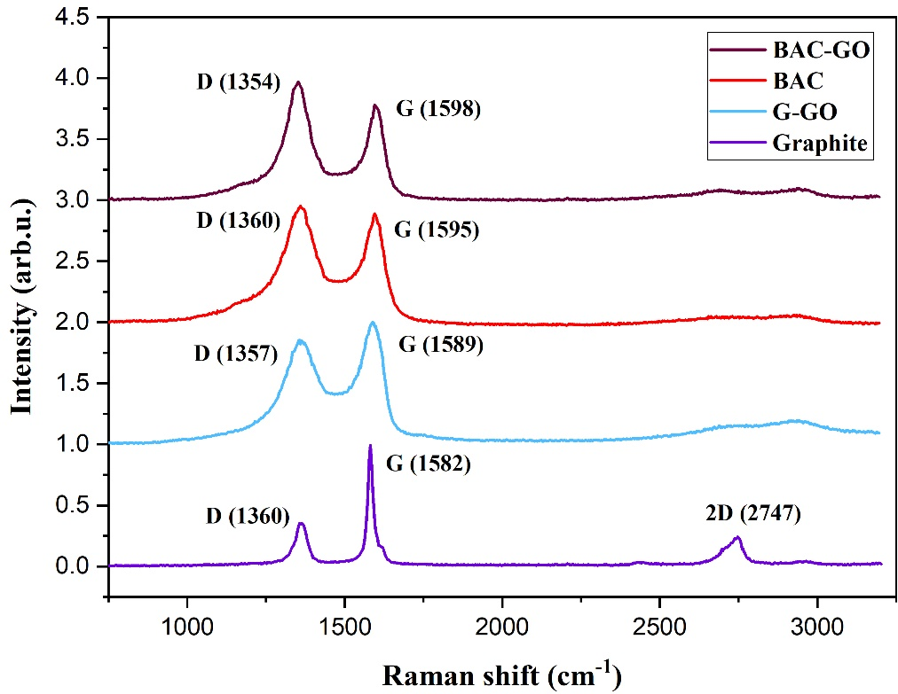
Figure 1. Raman spectra of graphite, G–GO, BAC, and BAC–GO.

Slide 13
Table 2. Ratios of the D and G bands (I_{D}/I_{G}) and crystal sizes of samples.
Samples | 2D | D-Band Position (cm⁻¹) | G-Band Position (cm⁻¹) | I_{D} (arb.u.) | I_{G} (arb.u.) | L_{a} (nm) | I_{D}/I_{G}
G | 2747 | 1360 | 1582 | 0.3642 | 1 | 33.09 | 0.3642
G–GO | Broad peak 2600–2800 | 1357 | 1589 | 0.8813 | 1 | 13.69 | 0.88
BAC |  | 1360 | 1595 | 1 | 0.8148 | 9.8 | 1.23
BAC–GO |  | 1354 | 1598 | 1 | 0.7158 | 8.67 | 1.39

Slide 14
Questions
1. Raman spectroscopy
2. Main peaks of Raman spectra
3. Characterization of FFLGN by Raman spectroscopy
4. Raman spectra

