Slide 1
«Nanotechnologies and Nanomaterials»
Lecturer: PhD doctor, senior lecturer, Tilek Kuanyshbekuly Kuanyshbekov

Slide 3
№ 4 FFLGN and FFLGN membrane
Graphene, GO and its related structures to this day continue to show interest in various fields of science and technology due to their physicochemical properties. Today, after the appearance of graphene in 2004, monoatomic carbon layer of graphene oxide has names as FFLGN.
One of the main directions of graphene related research is the study of its modifications, for example, graphene oxide, in the process of functionalization of graphene, which is the oxidation of graphite by strong oxidizing agents such as H₂SO₄, HNO₃, KMnO₄ as a result of which bulk graphite becomes functionalized with hydroxyl and epoxy groups on their main plane and at the edges of the carbonyl and carboxyl groups.
There are two basic types of functionalization of graphene: chemical and non-chemical. The chemical functionalization method is understood as chemical modification of the surface by various groups of atoms, as a result of which new covalent bonds between atoms native to reduced FFLGN/FFLGN and the guest functional groups are formed. In the case of nonchemical functionalization, mainly physical interaction occurs and functionalization occurs on the basis of π interaction between guest molecules and reduced FFLGN/FFLGN.

Slide 4
FFLGN is of great interest because of its low cost, a fairly simple synthesis method, availability, the ability to convert to graphene, also its scalability, which are an important feature
FFLGN is an important precursor for the synthesis of graphene, which is implemented using chemical or thermal reduction processes. FFLGN is a single sheet of the crystal lattice of graphite oxide, which is a compound of carbon, hydrogen, and oxygen in different ratios, which is formed when graphite is processed with strong oxidizing agents
It is stated that graphite and FFLGN have a layered structure, although, compared with graphite, FFLGN contains functional groups with high oxygen density, such as hydroxyl and epoxy groups on its basal plane and on its edge with less carboxyl, carbonyl, phenol, lactone and quinone which contribute expand of interplanar distance, and also makes it hydrophilic.

Slide 5
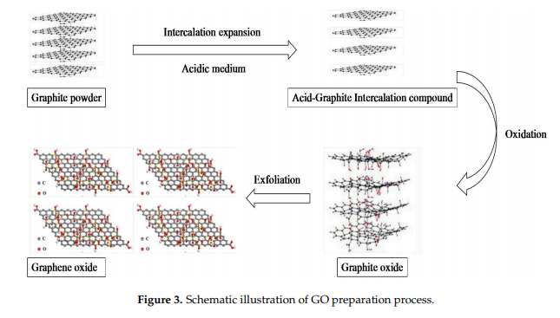
At this time, the synthesis of FFLGN is performed by oxidizing NFG by the next main approaches [75]: Staudenmaier [76], Hofmann [77], Hummers [73] and Tour [78]. The Hummers methods developed by Brodie or Staudenmaier have a number of advantages over the currently existing methods for producing GO [73, 75, 76, 79].
the main method of obtaining FFLGN and large-scale production of graphene is the Hammers method. Graphite is usually chosen as the initial material because of its availability and low cost. The synthesis FFLGN consists mainly of two stages: such as oxidation of graphite and exfoliation of graphite oxide,

Slide 6
Synthesis of an FFLGN membrane using vacuum filtration
Also, except obtaining FFLGN, the synthesis of the FFLGN membrane from a FFLGN solution is the most important for application in science and technology, in partically for creating humidity sensors and studying its electrophysical characteristics, which are discussed in Chapter 3.2.8 of this work.

Slide 7
For the manufacture of the FFLGN membrane, the following methods are used: filtration (vacuum, pressure filtration); casting-plating (spinning casting-plating, drop casting, two-piece coating); layer-by-layer assembly; evaporation; alignment method related with the shift and hybrid method [81].

Slide 8
From all the above methods in our experimental work, we chose vacuum filtration because its availability, low labor intensity, nano-sized control over the membrane thickness and the possibility of high-scale production of FFLGN membranes. FFLGN membranes using vacuum filtration were first obtained in work [84], in which FFLGN monolayers were connected almost in parallel, and also in this work, it is stated that during the preparation process, the physicochemical properties of FFLGN monolayers do not change [81, 84].

Slide 9
The synthesis of an FFLGN membrane using vacuum filtration consists of the following main processes: the selection of the appropriate concentration of FFLGN solution; FFLGN membrane is deposited by passing FFLGN solution through a porous film, then after the completion of the filtration, the resulting FFLGN membrane is dried [81, 83]. The result is a uniform dispersibility membrane with a relatively flat surface due to the fluidity of water in the solution filtration process, and the control of the film thickness depends on the concentration chosen.

Slide 10
Thus, obtaining FFLGN and FFLGN membranes are important for obtaining graphene in large quantities, as well as its application in many areas of science engineering.

Slide 11
Questions
1. GO and its related structures
2. Main directions of graphene related research
3. Functionalization of graphene
4. Synthesis of FFLGN
5. Method of obtaining FFLGN
6. Synthesis of an FFLGN membrane using vacuum filtration

