Slide 1
«Nanotechnologies and Nanomaterials»
Lecturer: PhD doctor, senior lecturer, Tilek Kuanyshbekuly Kuanyshbekov

Slide 3
№ 5 Reduction of FFLGN
The most attractive feature of FFLGN is the thermal reduction of graphene-like sheets, as a result of which oxygen-containing functional groups are removed, whereupon it’s electrical, optical and other properties change.
Currently, the properties of pure graphene and reduced FFLGN are close. Therefore, the reduction of FFLGN is one of the actual processes that allows obtaining graphene-like materials in large quantities and their application is important in science and technology.
In this regard, to obtain graphene in large quantities the following methods of the reduction process are used: chemical, thermal and electrochemical. As mentioned above, the use of these methods leads to obtaining FFLGN which electrical, thermal, mechanical properties are close to graphene

Slide 4
Methods of reduction
Chemical reduction process
hydrazine monohydrate, which is a good chemical reagent for the reduction of FFLGN.
Thermal reduction
thermal reduction in a flow tube in various atmospheres (argon, vacuum, hydrogen, hydrogen/argon) is currently widely used
The process of reducing FFLGN with hydrazine and its derivatives such as hydrazine and dimethyl hydrazine hydrate is the addition to the aqueous dispersion of FFLGN.
Chemical reduction process
hydrazine monohydrate, which is a good chemical reagent for the reduction of FFLGN.
The process of reducing FFLGN with hydrazine and its derivatives such as hydrazine and dimethyl hydrazine hydrate is the addition to the aqueous dispersion of FFLGN.
Electrochemical reduction
Electrochemical reduction of FFLGN sheets or films is performed in an electrochemical cell using an aqueous buffer solution at room temperature.

Slide 5
Temperature zones of reduction process
The process of temperature reduction of FFLGN to 2000 °C has 6 important temperature zones: 140-180 °С, 180-600 °С, 600-800 °С, 800-1000 °С, and 1000-2000 °С.
140-180 °C
At a temperature of 130 °C, due to the mild evaporation of intercalated Н2О molecules, a continuous intensive compression of GO crystals occurs. In the range of 140-180 °C, due to the rapid evaporation of intercalated Н2О molecules, GO crystals are partially exfoliated.
180-600 °C
600-800 °C
Within 600-800 °C, the residual carboxyl and partially hydroxyl groups are removed as gases.
In the range of 180-600 °C, the intermediate layers for all types of graphene and GO are contracted with the removal of the basic carboxyl groups
800-1000 °C
Within the range, of 800-1000 °C, residual hydroxyl and partially epoxy groups are removed
1000-2000 °C
In the range, of 1000-2000 °C, a decrease in the number of defects is observed

Slide 6
Preparation of GO
Graphene oxide was synthesized by two stages [26-31]: oxidation of graphite and exfoliation of graphite oxide, which is shown in Fig. 1, 2. The GO was prepared by the modified Hammers method using pure natural graphite. First, 23 ml of concentrated H2SO4 were added to a 250 mL ice flask at 0°C, which was filled with 1 g of graphite, after 0.5 g of sodium nitrate was added. Then, while stirring the mixture with a mechanical stirrer, 3 g of solid potassium permanganate was gradually added in the temperature below 20 °C for 2 h. After raising the temperature of the mixture to 35 °C, it was maintained for 30 min at this temperature, then, deionised water was added, after the temperature rose to 90°C and stirred for 30 min. Finally, 30% hydrogen peroxide was added until the color of the mixture changed to bright yellow and gas evolution ceased. Then the product was filtered and washed several times in 5% hydrochloric acid solution to remove metal ions, after washed with deionised water to remove acids. GO was synthesized according to our previous works [32, 33]. The GО synthesis process is presented below in a specific sequence (Fig. 1).

Slide 7
Exfoliation of graphene oxide (GO)
In the last stage of GO synthesis, important step is the exfoliation of multilayer graphene oxide sheets into few-layer graphene sheets. As a result of oxidizing graphite with strong oxidizers by the Hummers method, graphene oxide has a large number of oxygen-containing functional groups on both sides and edges of the graphite sheet, which helps to increase the distance between the layers. The process of exfoliation of graphene oxide is carried out using centrifugation and ultrasonic treatment, as a result of which GO is exfoliated into multilayer, even single-layer sheets. The GO suspension was treated with a centrifuge at a rotation speed of 5000 rpm, then processed by ultrasound at a frequency of 45 kHz (UZTA-0.15 / 22-0, Russia) at a temperature of 25 °C for 60 minutes (Fig. 1) [33].

Slide 8
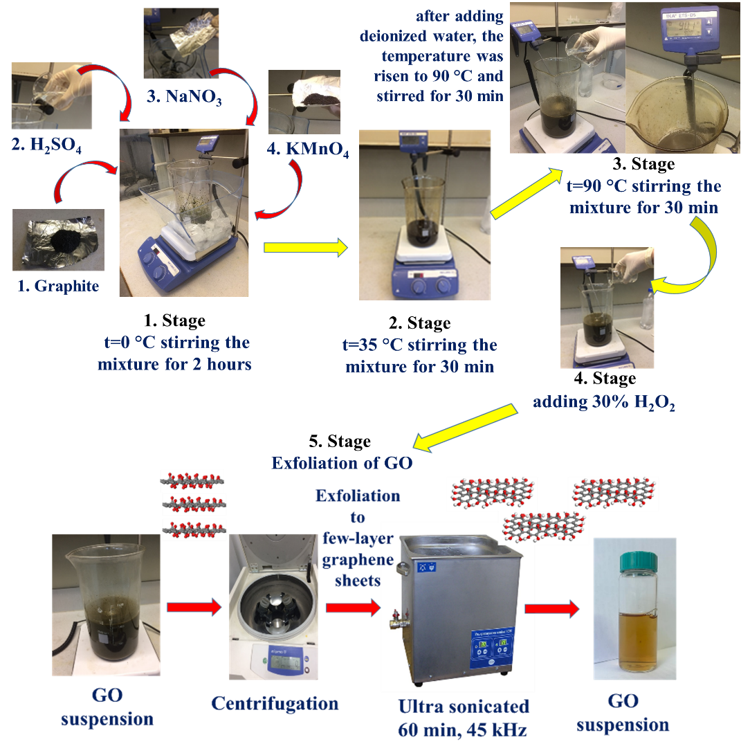
Fig. 1 Stage of synthesis GO suspension

Slide 9
Preparation of GO membrane
In order to obtain the GO membrane, the following methods are used: filtration (vacuum, pressure filtration); casting-plating (spinning casting-plating, drop casting, two-piece coating); layer-by-layer assembly; evaporation; alignment method which is related to the shift and hybrid method [34].
From all the above methods in our experimental work, we chose vacuum filtration because of its availability, low labor intensity, nano-sized control over the membrane thickness and the possibility of high-scale production of GO membranes. GO membranes using vacuum filtration were first obtained in work [35], in which GO monolayers were connected almost in parallel. Also in this work, it is stated that during the preparation process, the physical and chemical properties of GO monolayers do not change [34, 35].

Slide 10
The synthesis of GO membrane using vacuum filtration consists of following main steps: the selection of the appropriate concentration of GO solution; GO membrane is deposited by passing GO solution through a porous film, then after the completion of the filtration, the obtained GO membrane is dried [34, 36]. The result is a uniform dispersible membrane with a relatively flat surface due to the fluidity of water in the solution filtration process. The thickness of obtained film depends on the concentration.
In order to prepare GO membrane, we used the vacuum filtration method. In order to do that, 200 mLsuspension of GO (C= 1.5 mg/mL) was filtered through a porous alumina membrane filter. The GO membrane was left to dry at 252C for 48 h and then separated from the filter (Fig. 2).

Slide 11
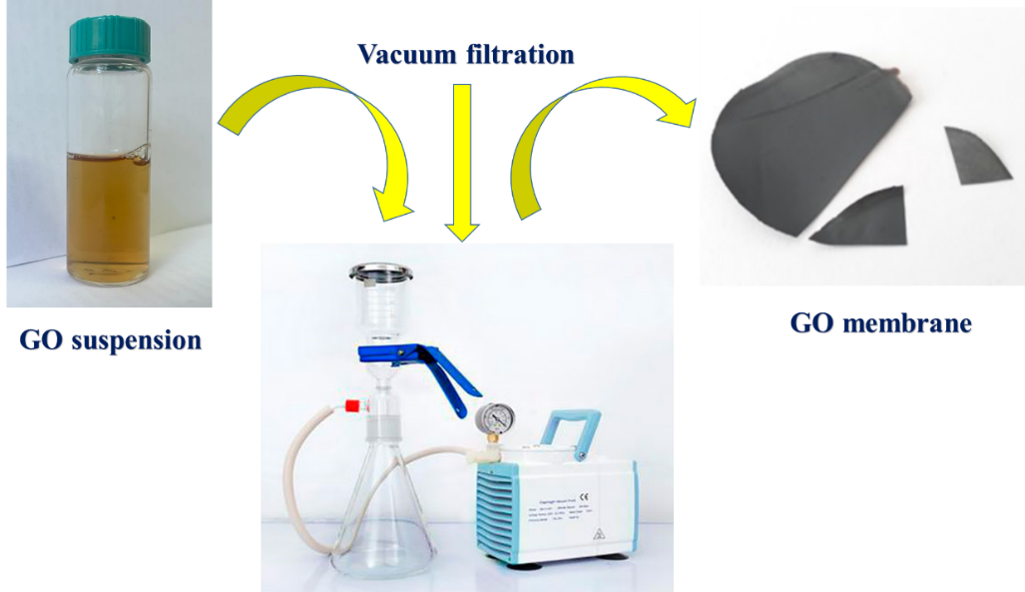
Fig. 2 Preparation of GO membrane.

Slide 12
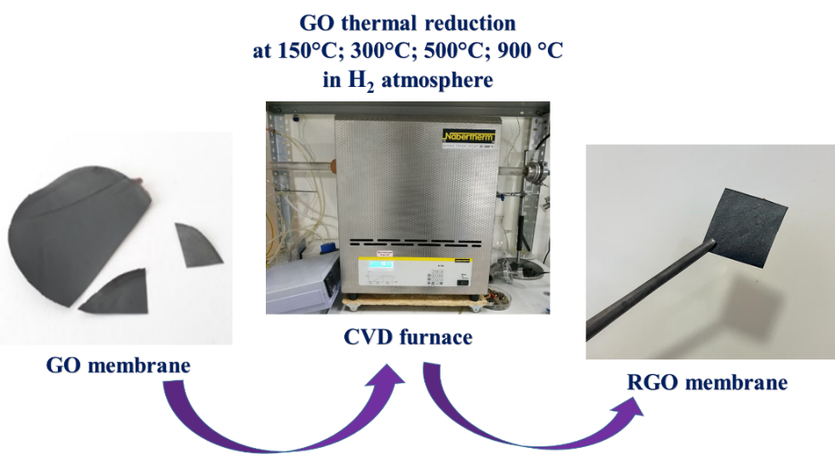
Fig. 3 Thermal reduction of GO membranes

Slide 13
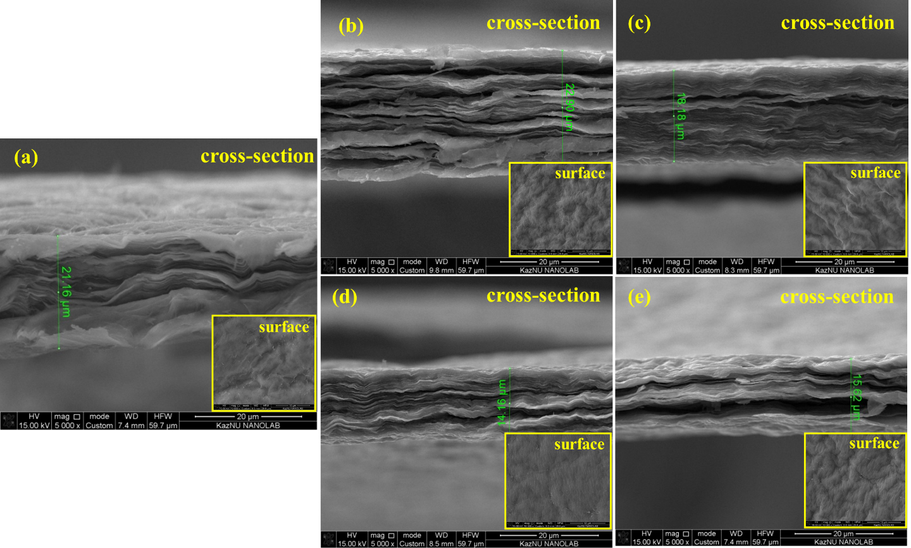
SEM of GO and RGO membrane
Fig. 4 SEM images of: a) initial GO; b) RGO 150 °C; c) RGO 300 °C; d) RGO 500 °C; e) RGO 900 °C

Slide 14
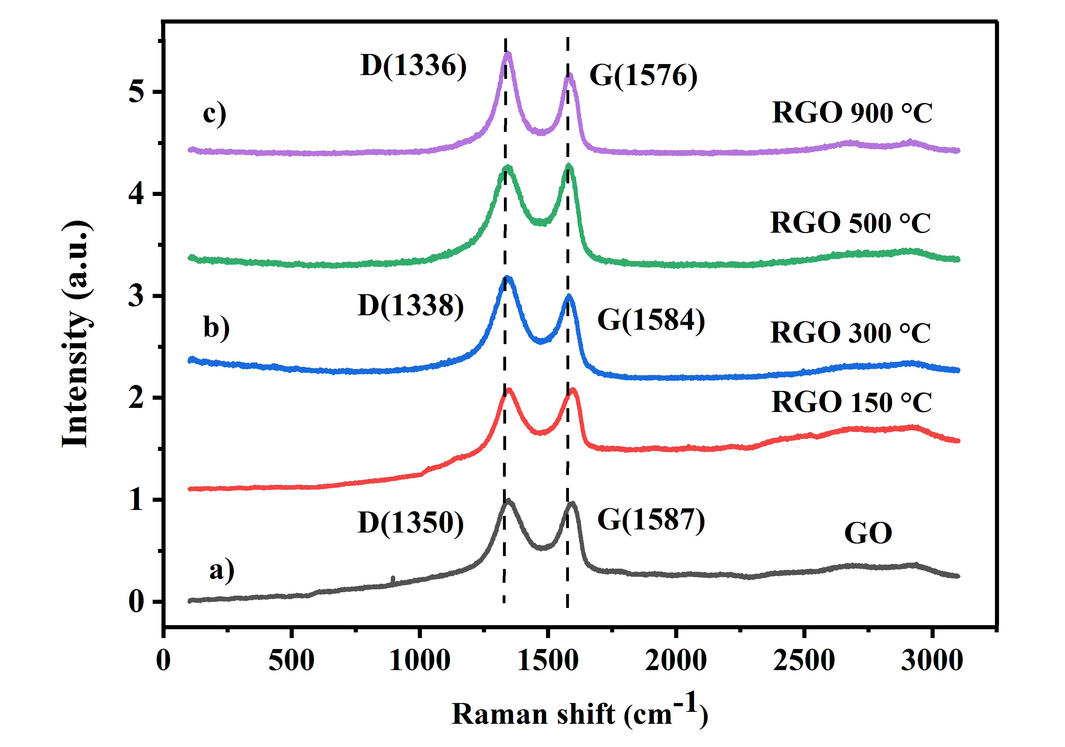
Raman spectroscopy of GO and RGO membranes
Table 1
Intensity G and D bands of the GO and RGO samples at temperatures: initial, 300 °C, 900 °C
Samples, °C | G – band (cm⁻¹) | D – band (cm⁻¹)
GO | 1587 | 1350
Reduced GO 300°C | 1584 | 1338
Reduced GO 900°C | 1576 | 1336
Fig. 5 Raman of GO and RGO samples

