Slide 1
«Nanotechnologies and Nanomaterials»
Lecturer: PhD doctor, senior lecturer, Tilek Kuanyshbekuly Kuanyshbekov

Slide 3
№ 4 Application of FFLGN membrane as a humidity sensor and comparison of its performance
This section provides an overview of the application of a humidity sensor based on graphene, graphene oxide, FFLGN membrane, and other carbon materials, in turn, these materials are durable and have high thermal conductivity, as well as excellent adsorption characteristics , therefore they are important practical application as a humidity sensor.
The membrane based on FFLGN, GO, compared with other carbon materials, contains functional groups such as hydroxyl, carbonyl, and carboxyl on their basal plane and this makes it hydrophilic; therefore, sensors based on such materials are moisture-sensitive
Therefore, according to the above-listed properties, FFLGN is currently an important material for creating humidity sensors with high sensitivity, which is necessary for such fields of engineering and science as medicine, textile industry, agriculture, biological products, scientific and technical centers, food industry and other industries

Slide 4
To create humidity sensors, the most important electrophysical characteristics are: faster response and short recovery time; stability of work at various levels of humidity and in aggressive environments; a wide range of moisture detection, as well as the most important are the ease of manufacture technologies, low cost, which are necessary to satisfy consumers
In this regard, as the initial material, we choose the FFLGN membrane, which is one of the potential materials to satisfy the above characteristics, and the choice of a suitable material is considered the most important factor in creating a sensitive sensor.
To achieve the above listed characteristics over the years, much attention has been paid to the creation of various types of sensors with high sensitivity based on such materials as: metal oxide nanowires; ceramic nanomaterials; silicon; semiconductor nanoparticles, etc., but despite this the creation of sensors with the above-listed characteristics remains an unsolved task to this day
Due to the physicomechanical and important electronic properties of graphene and graphene-like materials, there has been more research and many studies have been done on the creation and use it as sensors for determining various gases and humidity.

Slide 5
The use of graphene in sensors for the determination of various gases was first demonstrated in [140], then its related structures such as FLG, GO have become more investigated and used to create nanoscale sensors [135].
Humidity sensors using graphene structures were created for the determination of NO₂, NH₃, and CO₂ gases, which were demonstrated on the basis of the following materials and principlesgraphene of operation of thermally reduced graphene; epitaxial; carbon nanotubes and graphene; coarse-grained GO thin film; FLG, microscale capacitive humidity sensor based on GO film; high proton conductivity GO; capacitive humidity sensor based on the Electro-spun PVDF/Graphene Membrane
We made a comparison of the performance of humidity sensors based on FFLGN with similar types of humidity sensors according to the following characteristics: dynamics of response and recovery, humidity detection range
According to the table 2, compared to the sensors listed below, our device [206] has an advantage in response and recovery time, which has the same time of 360 s, as well as a wide range of humidity from 5-100%, and its electrophysical characteristics presented in section 3.2.8.

Slide 6
Creation a humidity sensor based on an FFLGN membrane and studying its electrophysical characteristics
In this section, we present the results of the humidity sensor research on the stability of the capacitance reading and electrical resistance under different levels of constant humidity as a function of time, also, the dependence of capacitance and the dependence of the electrical resistance on humidity. The FFLGN membrane sensor was tested under fixed humidity conditions in a wide range at room temperature for 10 hours [24-26].

Slide 7
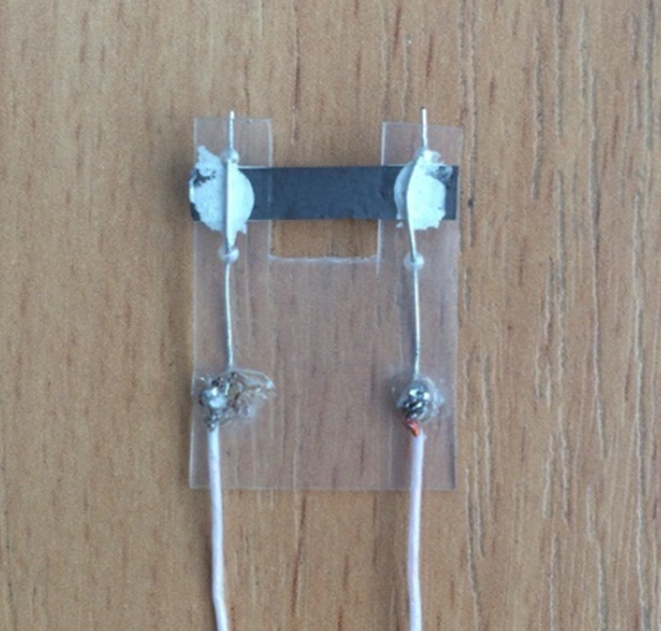
The design of the humidity sensor is shown in Figure 1, where the FFLGN membrane was mounted on a dielectric substrate and connected at opposite ends with copper wire (0.15 mm in diameter) as electrodes with an FFLGN sample. These electrodes were covered with conductive silver paint contacts and left to dry overnight to ensure good electrical contact [21, 22].
Figure 1 – Structure of the humidity sensor

Slide 8
The substrate of the sensor has following dimensions: 2.5*1.8 cm, the FFLGN membrane thickness is about 20 μm, as shown in Figure 1 (b), the length is 2.5 cm, and width is 0.5 cm. The surface of the FFLGN membrane is open on both sides, which allows to react sensitively to the relative humidity of the environment.
As can be seen from the schematic in Figure 1, a humidity sensor based on FFLGN and an exemplary DHT 22 sensor by the Arduino platform are placed together in the testing chamber, which was used to control the humidity and DHT 22 sensor has the following technical characteristics: calculated to measure the level of humidity in the range from 0 to 100 % and the measurement accuracy is in the range of 2-5 %. Schematic representation of installation for investigating the sensitivity of the sensor to humidity shows in Figure 2.

Slide 9
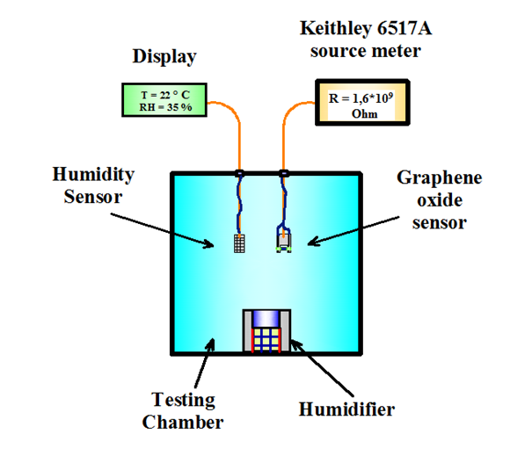
Figure 2 – Schematic view of the installation

Slide 10
The electro-physical parameters were studied as a function of humidity to determine the operating characteristics of the device. The stability of the electrical capacitance was monitored using the Keithley 6517A meter attached to the copper electrodes with alligator clips. The results of testing the sensor for the stability of the electrical capacitance under various levels of constant humidity, depending on the time are shown in Fig. 2. It can be seen from the results that the deviation of the electrical capacitance values of the structure for a long time does not exceed 2 %

Slide 11
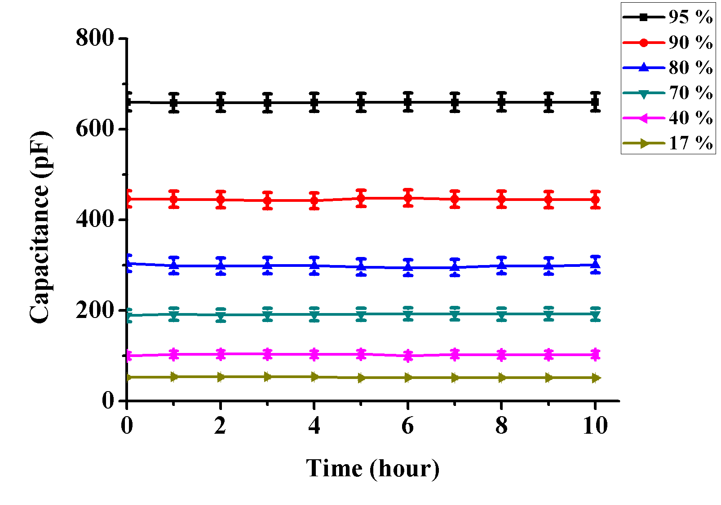
Figure 2 – Testing the humidity sensor for the stability of the capacitance reading under various levels of constant humidity as a function of time

Slide 12
The humidity sensor was kept in the sealed chamber with humidity levels controlled at 5 %, 25 %, 50 %, 75 %, 100 % for 10 hours. The results of testing the sensor for the stability of the electrical resistance under various levels of constant humidity, depending on the time are shown in Figure 3. It can be seen from the results that the deviation of the electrical resistance values of the structure for a long time does not exceed 2 %.

Slide 13
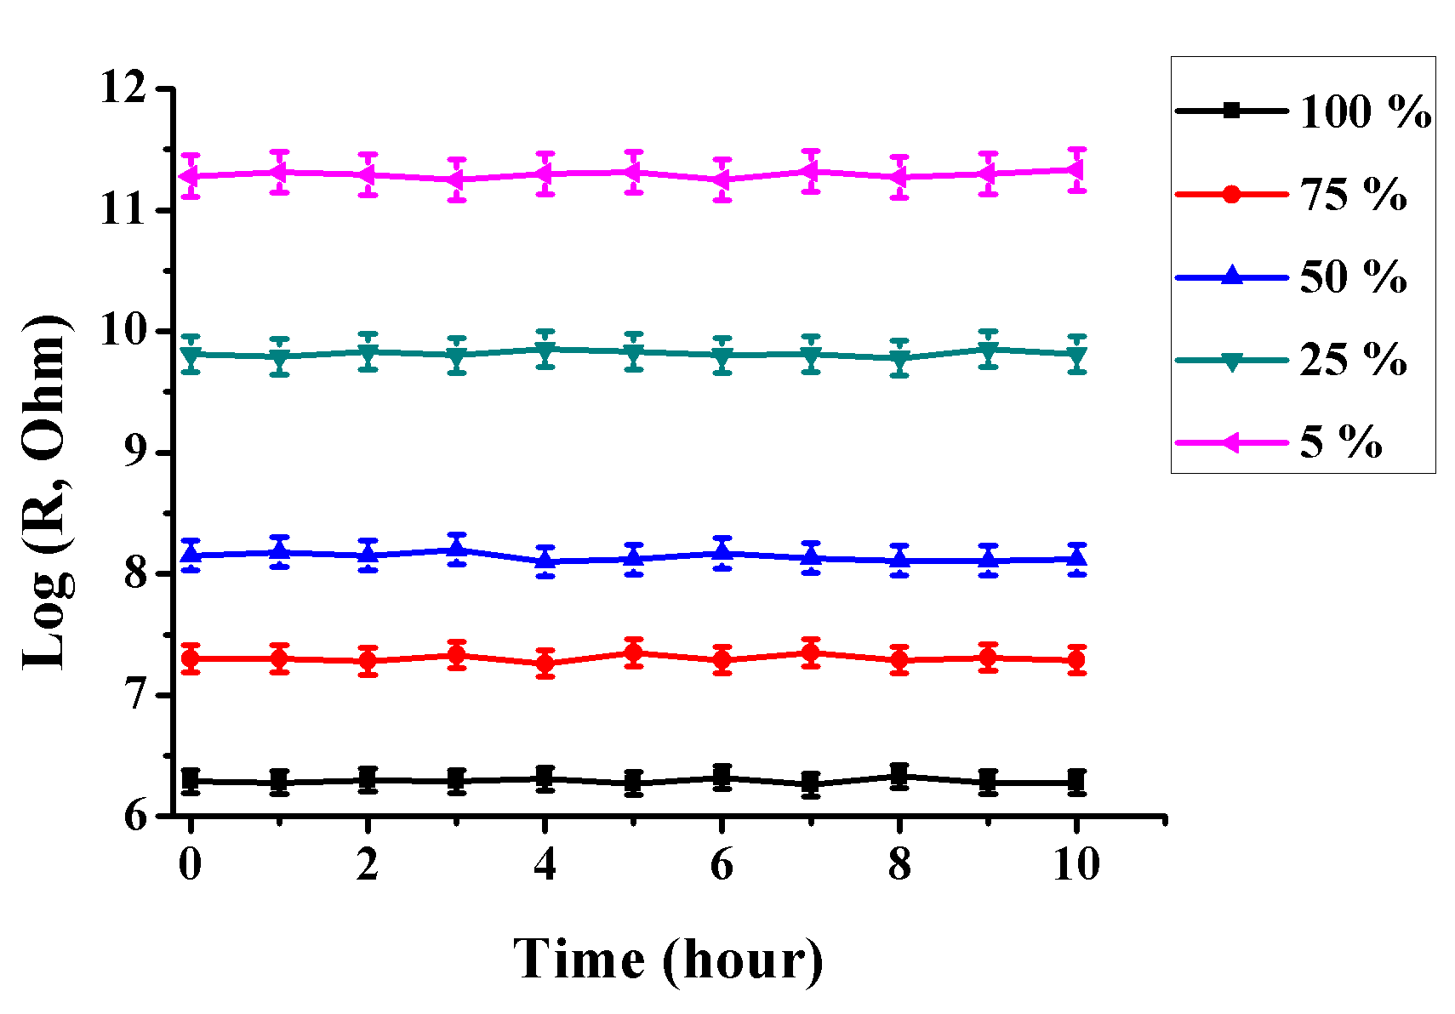
Figure 3 – Testing the humidity sensor on the stability of the electrical resistance readings under different humidity levels

Slide 14
Figure 4 shows the dependence of capacity on humidity. This figure shows that as the humidity level increases, the capacity of the sensor increases. Significant changes in capacity are observed at 70%, 80%, 90%, 95% humidity, this is due to the fact that a large amount of water vapor penetrates into the interplanar distance of FFLGN membrane and due to the high dielectric permeability (constant) increases the electrical capacitance.

Slide 15
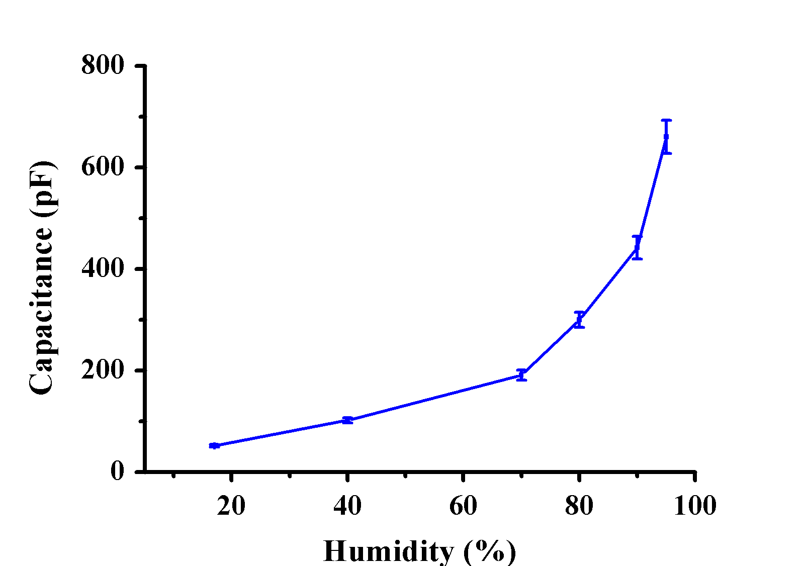
Figure 4 – Dependence of capacity on humidity

Slide 16
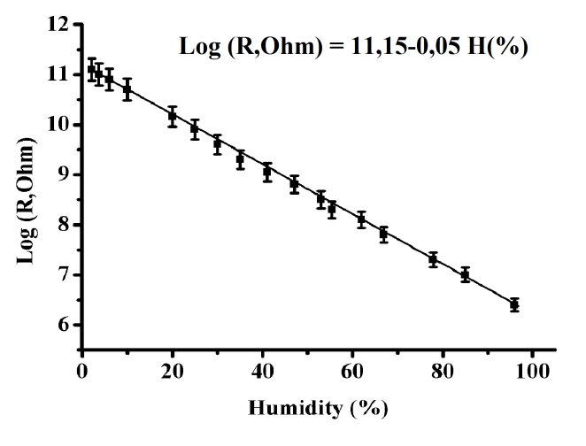
The electrical resistance versus humidity is presented in Figure 5. This image shows that the electrical resistance of the sensor decreases from 11,5 to 6,3 Log (R, Ohm) with increasing humidity at the range of 5-100 %.
Figure 5 – Dependence of the electrical resistance on humidity

Slide 17
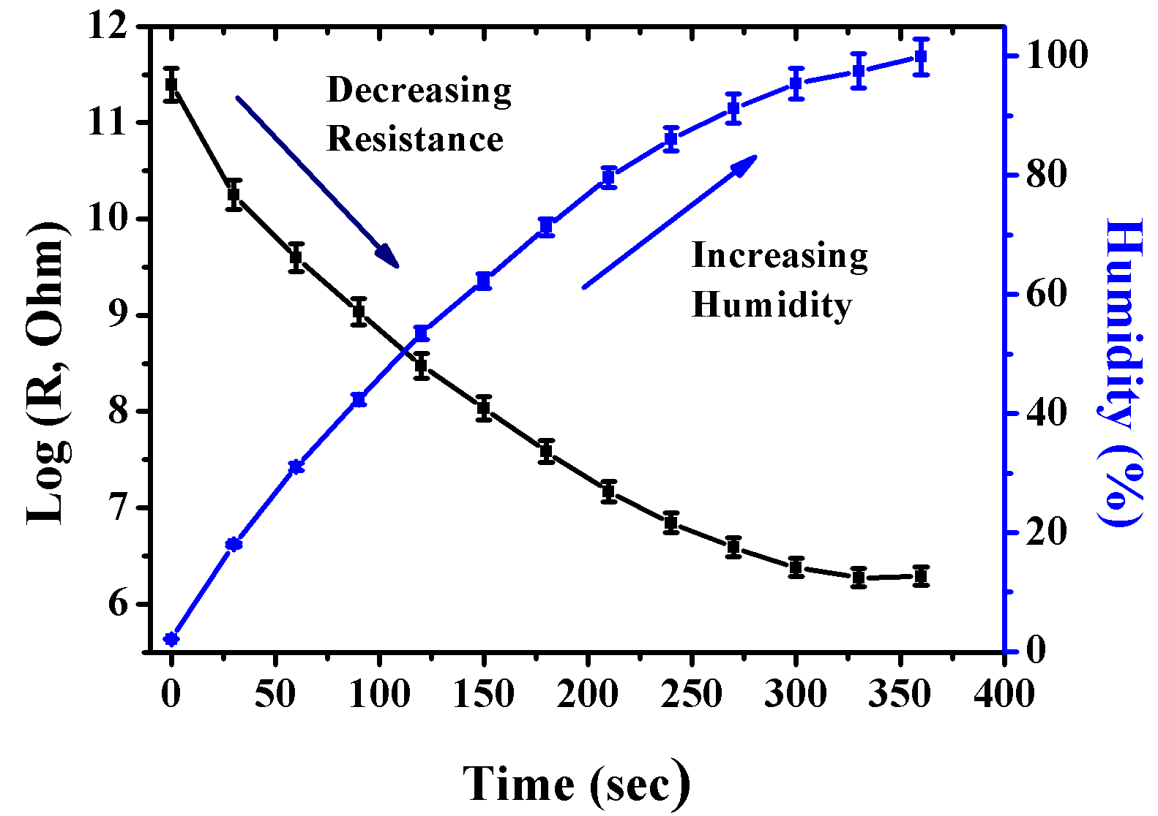
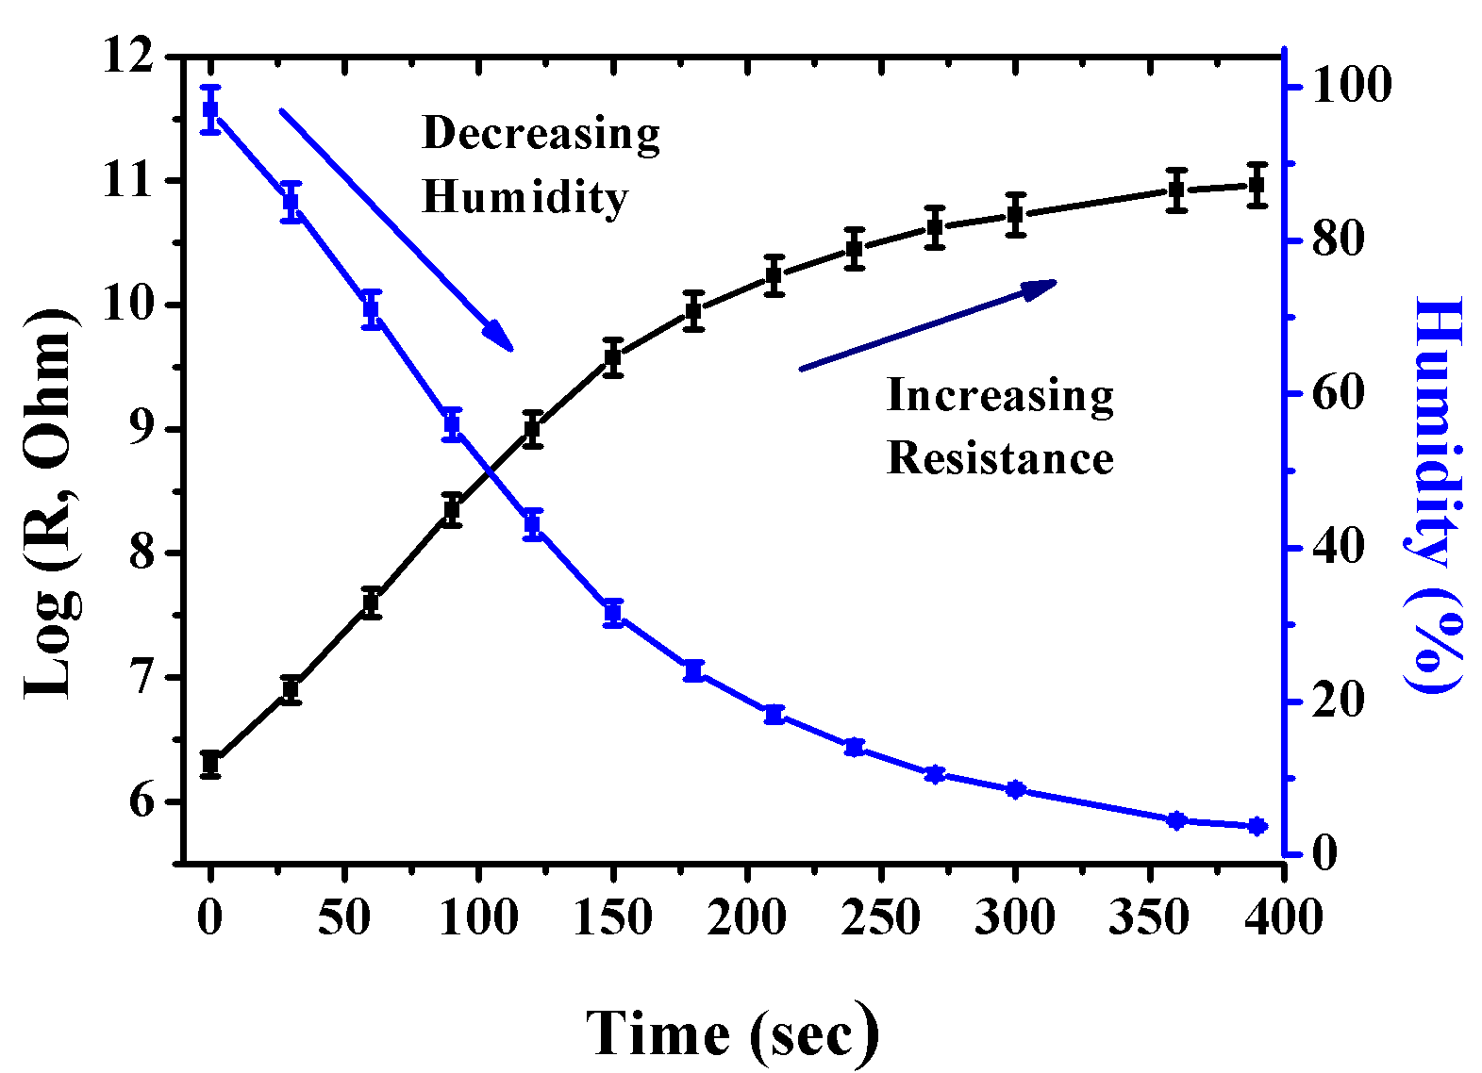
The recovery and response time of the sensor
Figure 6 – Dynamics of the response
Figure 7 – Recovery dynamics

Slide 18
Questions
Application of a humidity sensor based on graphene
Physicomechanical and important electronic properties of graphene and graphene-like materials
Characteristics of humidity sensors
Creation a humidity sensor based on an FFLGN membrane
Dependence of capacity on humidity
The recovery and response time of the sensor

