Slide 1
«Nanotechnologies and Nanomaterials»
Lecturer: PhD doctor, senior lecturer, Tilek Kuanyshbekuly Kuanyshbekov

Slide 3
№ 5 Basics of computer simulation
Computational science begins to play an important role in research and development. Nowadays modern scientific research initially based on experiment and its theoretical interpretation, which is become a triad of experiment, theory and computer simulation.
At this time computer modeling has such interchangeable terms as computer modeling and simulations, which are successfully used in the following areas of science and technology: design, production management, business, science, technology, architecture, entertainment, government, military and logistics/transportation.
Computer modeling is used to reduce the risk associated with creating new systems or making changes to existing ones. More than ever, modern organizations want to be sure that investment will lead to expected results.

Slide 4
Compared to decision-making methods, using computer simulation for analysis has the following advantages:
- allows to experiment without failures in existing systems, new ideas that are difficult, costly or impossible, as well as develop a model and compare it with the system to ensure that it accurately reflects current work.
- the next advantage is the speed in the analysis in the simulation. The advantages of this process are that after developing a model, you can run a simulated system at speeds far exceeding those achievable in the real world.
- using computer simulation it is possible to, check an advanced idea before setting, which allows identifying unexpected disadvantages in the construction and these disadvantages useful for improvement construct as instructions

Slide 5
In addition to the above advantages in computer modeling, there are general limitations as follows:
- one of the flaws is an expensive analysis method for creating a computer model, but, despite this drawback, low-cost modeling packages are available, and most of the large-scale modeling work is the main enclosure in training, software, hardware, analysis.
- the next disadvantage is laboriousness (labor intensity), which does not always give a quick answer to the questions, in most cases, data collection, model development, analysis and report generation take considerable time.
- gives only approximate answers when modeling discrete events, which is based on the use of random number generators and in the process of modeling, the input has a random element, some uncertainty is also associated with the output

Slide 6
Computer modeling of molecular dynamics (MD) has become a very useful technique for studying many types of properties of layered nanomaterials, such as graphene, GO, few-layer graphene nanostructures, FFLGN, which have wide interest in various fields of science and technology, such as military technology, biotechnology, nanoscience, biomedicine, etc. In addition, research of its physical, chemical and electronic properties has paid considerable attention from researchers.

Slide 7
Figure 1 (a, b) shows computer models of possible stable configurations of the bond atom C – atom O, O-H radicals. According to Figure 21 (a), one can see the created computer models of possible stable configurations of the C atom, an O atom, which can form on the surface and on the edges, as well as configurations of the OH radical type. The length of the bonds of the configuration atom C – the atom O of the surface is 1.45 A, the edge 1.2 A, and the O–H radicals are 1.0 A.

Slide 8
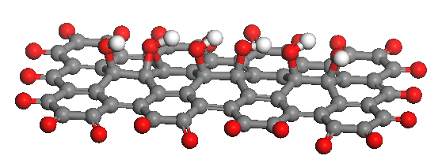
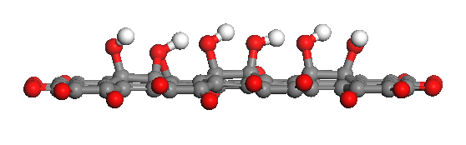
a) C – O = 1.45 A (surface), C – O = 1.2 (edges), O – H = 1.0 A
b) Binding energy of O: edges 0.5 eV, surface: 4 eV, bond surface: O – H: 2.1 eV, H - 0.9 eV (from O – H)
Figure 1 – Computer models of possible stable configurations of the bond atom C – atom O, O-H radicals

Slide 9
Based on calculations of DFT, the binding energy of the C atom and the O atom configurations at the edges equal to 0.5 eV, 4 eV on the surface, and the OH bond radical energy on the surface is 2.1 eV, and the H of OH radicals is 0.9 eV, which are in Figure 1 (b). The carbon atoms associated with OH radicals rise from the sheet by about 0.3 A.
Figure 2 (a, b, c) presents computer models of functionalized graphene and their typical configurations of C–O and O–H radicals. According to Figure 22 (a), C – O = 1.3 (surface), C–O 1.2 (edges), also the bond length of C–O of the O–H configurations radicals is 1.4 A, and the binding energy E_{b} (O–H)-C = 1.4 eV; E_{b} (H) = 3 eV, H-L = 0.03 (Figure 22 (b, c)), and the distance C-sheet = 0.2 A.

Slide 10
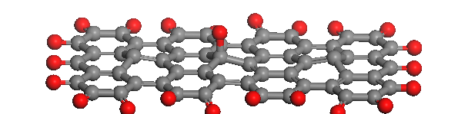
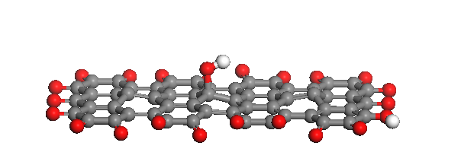
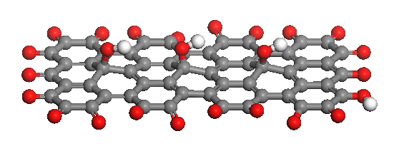
а)
b)
c)
Figure 22 – FSLGN computer configuration models:
a) configuration of C – O atoms;
b, c) configurations of OH radicals

Slide 11
Questions
Advantages in computer modeling
Computer modeling of molecular dynamics (MD)
Computer simulation of possible stable structures of graphene and few-layer graphene functionalized Ga
A possible structure of Ga-atom
Computer Simulation of FSLGN

