Slide 1
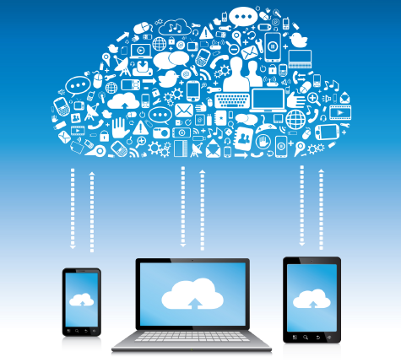

10. CLOUD AND MOBILE
TECHNOLOGIES
Notes:
Welcome to this series on cloud technologies! The first video focuses on the cloud. The second one describes how mobile and cloud technologies work together.

Slide 2

Copyright Notice
This presentation is presented as is. This presentation was assembled using information from various websites or sources across the web.
This presentation uses Creative Commons Attribution 4.0 International (CC BY 4.0). © 2019 BilimEdtech

Slide 3
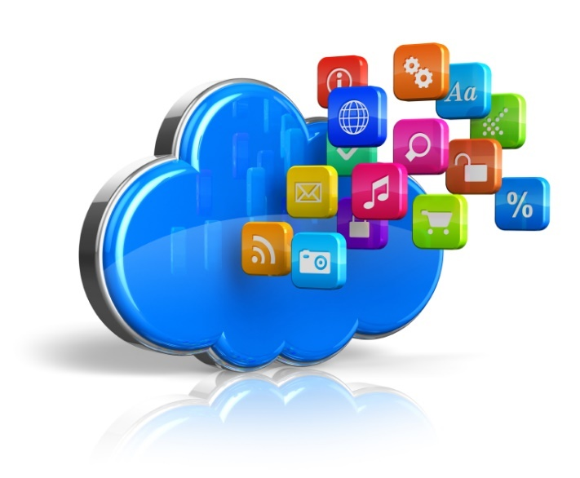
10.1. Cloud Computing
10.1. Cloud Computing
10.2. Mobile Cloud Computing
Notes:
During part one, we explore cloud computing.

Slide 4
Learning Objectives
Explain cloud computing in simple terms
Describe infrastructure, platform and software
Describe SaaS, PaaS, and IaaS
List advantages and disadvantages of cloud computing
Notes:
Please take a moment to read the learning objectives for this video.

Slide 5
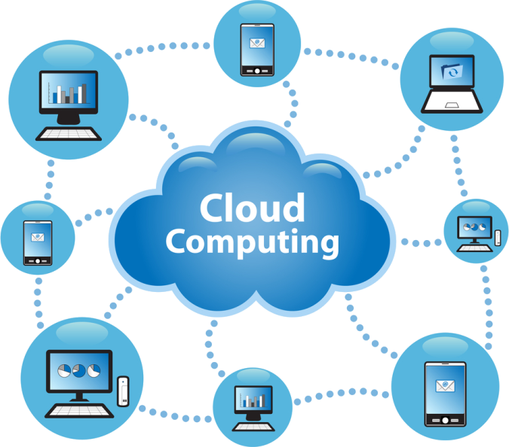
Cloud computing is…
Internet-based computing
Using web services for our computing needs
Providing shared resources,
software, and information
to computers and other devices
on-demand through the Internet.
Notes:
Cloud Computing is a general term used to describe computing that takes place over the internet. In short, it is internet-based computing. Unlike traditional computing that happens only on the computer, cloud computing shares the processing power between the client and the server. Cloud computing can use web services for computing, such as editing an image using Google Photos. Cloud computing provides shared resources, software, and information to computers and other devices on demand through the Internet.

Slide 6
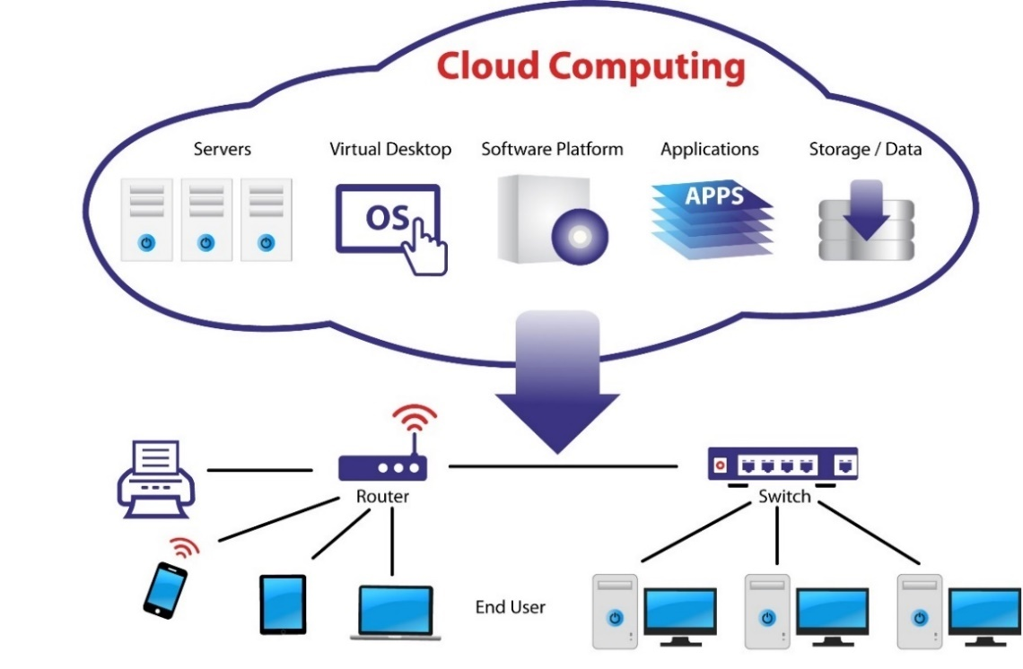
Cloud computing provides…
Software Applications
Data storage
Computing power
Software platforms
Virtual computers
Virtualized infrastructure
Notes:
Cloud computing has many applications and usages. First, it allows software applications to run through a web browser, instead of a standalone application. Next, it can replace physical servers in an office building with data storage or processing in the cloud. Thirdly, it distributes processing power among many servers instead of using only the client’s processing power. Next, cloud computing provides developers and organizations with software platforms that they can then use to build their applications. Finally, cloud computing allows for running virtualized computers and infrastructure that an engineer can easily change to meet new requirements.

Slide 7
Cloud computing: Everyday usage
Cloud computing is where computing will happen in the future
However, you use it every day
  Online email services (Gmail, Mail.ru, Yandex)
  Online documents (Google Drive, OneDrive)
  Online translation services
  Video/audio streaming
Notes:
Cloud computing is where computing will happen in the future. More and more processing will occur in the cloud. However, you use it every day even though you may not understand the technology. For example, the common email providers, such as mail.ru or Gmail, all use cloud computing. When you use an online translation service, such as Google Translate, you use cloud computing. The server accepts your text, builds the translation, and then returns the result to you.

Slide 8

Components
Cloud computing has two main components
  Frontend
  Backend
Notes:
There are two main perspectives to cloud computing. The frontend and the backend. As a user, you only see the frontend. Just like with an iceberg, the backend remains hidden.

Slide 9
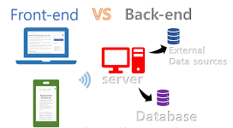
Components: Frontend
The frontend of cloud computing is the part seen by the client (i.e., the computer user)
  Computing device
  Web browser
  Mobile application
Notes:
The frontend of cloud computing is the part seen by the client, which is the computer user. The frontend includes things like the computing device, web browser, or mobile application. The user can only see and interact the data displayed on the web page. However, that data might be spread across many databases or servers.

Slide 10
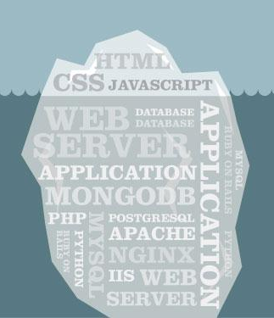
Components: Backend
The backend is the “cloud” itself
Compromised of various computers, servers, and data storage devices
  Web server
  Databases
  Storage devices
Notes:
The backend is what we refer to as the cloud. The cloud contains all of the various computers, servers, and storage devices required for the application. The backend has many layers that work together to send the pertinent data and presentation to the user. For example, a web page is a simplistic view of the data that a user needs or can understand. However, the backend is very complex. Before the web server can send the data to the client, it has to retrieve data from multiple databases and storage devices.

Slide 11
Cloud computing is a service
Services are not free
Someone always pays for the service
  For example, you pay your ISP for bandwidth to connect to the internet
What about “free” services?
Your pay by
  giving away your data
  viewing ads
What does Facebook get in return?
Notes:
Before we explore how the cloud operates, we should note that cloud computing is a service. As you know, services are not free. Someone always pays for the service. For example, you pay your ISP for bandwidth to connect to the internet. Or, you pay your mobile provider for phone service and mobile internet access. Some services are free to use, but someone still has to pay for them. The question is, who? For example, you do not pay a fee to drive a car on the road. However, you pay taxes to the government who then maintains the road. You pay for the free internet services you use by allowing the company to monetize your data. For example, Facebook will sell your data to advertisers or charge a fee for researchers to access your data.

Slide 12
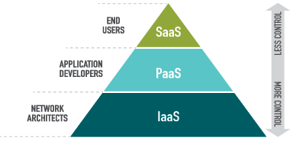
Cloud Computing Model (1)
Cloud computing services are built on layers
Each layer performs a specific function
IaaS provides the foundation
Notes:
Основание пирамиды «инфраструктура» – это набор физических устройств (серверы, жесткие диски и т.д.), над ней выстраивается «платформа» – набор услуг и верхушка – программное обеспечение, доступное по запросу пользователей.
The services for cloud computing or internet-based computing are built on layers. Each layer performs a specific function. Like many services, the infrastructure provides the foundation. Without a strong foundation, any service will collapse. The foundation includes the hardware for moving, storing, and processing the data. Let’s define each of these layers that make up the cloud.

Slide 13
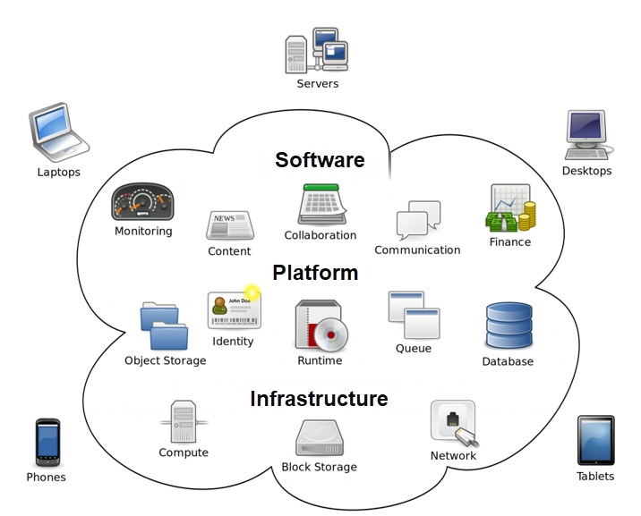
Cloud Computing Model (2)
The cloud!
Software as a service (SaaS)
Platform as a service (PaaS)
Infrastructure as a service (IaaS)
Notes:
The foundation layer that makes up cloud computing is infrastructure as a service or IaaS. Network architects and engineers construct this layer for the cloud computing services to use. The next layer is platform as a service or PaaS. Application developers use this layer to develop software services. Software as a service or SaaS uses the platform and infrastructure services to run applications, which you use as the end user.

Slide 14

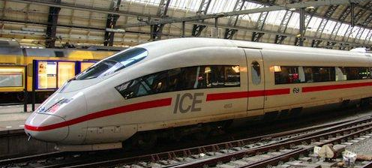
What is Infrastructure?
The essential physical and organizational structures and facilities (e.g., buildings, roads, and power supplies) needed for the operation of a society or enterprise
Notes:
So, what is infrastructure? It is the essential physical and organizational structures and facilities, such as buildings, roads, and power supplies, needed for the operation of a society or enterprise. Roads are a critical infrastructure so people can travel with ease.

Slide 15
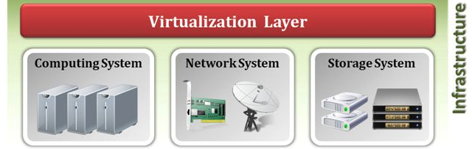
Internet Infrastructure
The internet infrastructure is composed of resources that support the flow, storage, processing, and analysis of data
Notes:
The internet infrastructure consists of resources that support the flow, storage, processing, and analysis of data.
Network services move and direct the data to the correct location.
Large data centers store cloud data.
Physical servers provide the processing power required to manipulate or analyze the data.

Slide 16
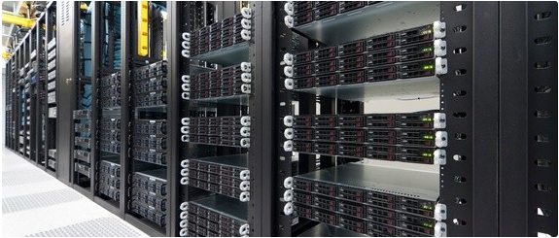
Data Centers (1)
A data center is large group of networked servers for storing, processing, or distributing data.
Notes:
Data centers make up part of the cloud computing infrastructure. A data center is a large group of networked servers for storing, processing, or distributing data.

Slide 17
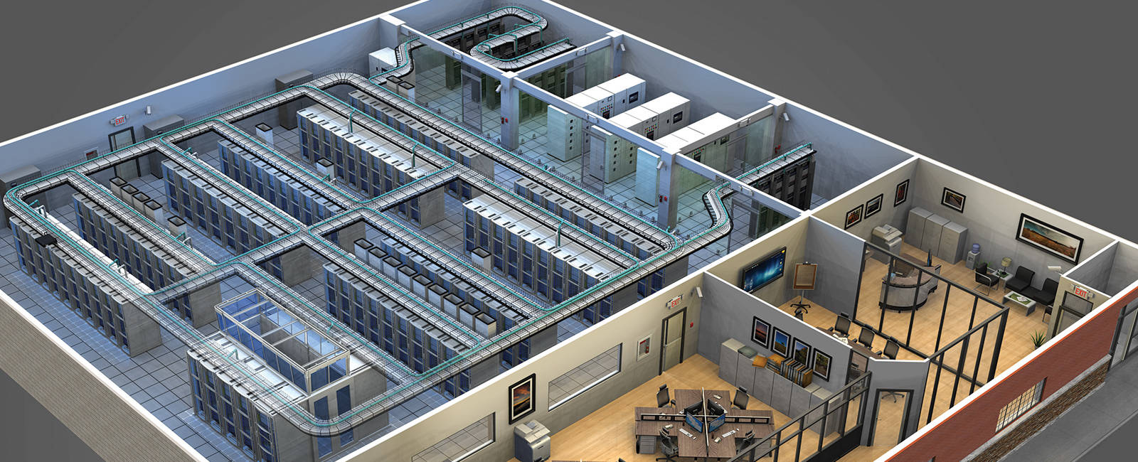
Data Centers (2)
It is a physical place that houses a computer network's most critical systems, including backup power supplies, air conditioning, and security applications.
Notes:
A data center is a physical place that houses a computer network's most critical systems, including backup power supplies, air conditioning, and security applications.

Slide 18
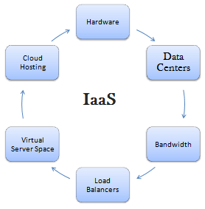
Infrastructure as a Service (IaaS)
Hardware provided by a service provider and
managed for the service subscriber
Physical or virtual
  Data centers
  Servers
  Storage devices
  Networking services
Notes:
IaaS manages and provides the infrastructure for subscribers. The subscribers do not manage or control the underlying cloud infrastructure. Instead, they control the software that uses the hardware, such as an operating system or configuring a firewall. The infrastructure might be physical or virtual. Examples include data centers, individual servers, storage devices, and networking services.

Slide 19
Who subscribes to or uses IaaS?
Large companies who don’t want to manage their own infrastructure
VPN service providers
  Primarily use networking services
Developers who need aspects of an infrastructure
  Scalable data storage and bandwidth
  For example, hosting videos for a streaming service
Notes:
So then, who subscribes to or uses IaaS? One category is large companies who don’t want to manage their own infrastructure. Instead, they would contract out to an IaaS provider to maintain the hardware. Another category is specific industries, such as VPN service providers. This category of subscribers would primarily use the networking infrastructure. A smaller group might use IaaS for scalable data storage and bandwidth. For example, a small company might start a video streaming service. Instead of paying for a significant amount of bandwidth available all the time, they would operate on a pay-per-use basis, meaning they only pay for the bandwidth they use. The IaaS providers automatically increase bandwidth on demand.

Slide 20
What is a computing platform?
A computing platform is an environment in which a piece of software is executed
It could be
  The hardware, in the case of an embedded system
  The operating system (OS) that hosts an application
  An application, such as a web browser that runs web-based software
Notes:
The next layer is PaaS. But, what is a computing platform? A computing platform is an environment that executes or runs software. It could be the hardware, in the case of an embedded system. More commonly, it is the operating system (OS) that hosts an application. There are also many smaller forms of computing platforms, such as a web browser that runs web-based software. Software developers commonly use a computing platform for developing or deploying their software.

Slide 21
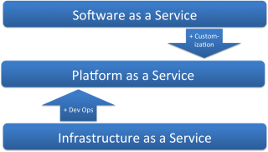
Platform as a Service (PaaS)
Used to host an application or service
Notes:
PaaS is used to host an application or service on a cloud-based server. Software as a service uses PaaS to run the application.

Slide 22
Platform as a Service (PaaS)
Provides a platform and environment to allow developers so they can build applications and services over the internet
The developer does not manage or control the underlying cloud infrastructure but has control over the deployed applications
Notes:
Пользователю предоставляется компьютерная платформа с установленной операционной системой и некоторым программным обеспечением.
PaaS providers supply a platform and environment that allow developers to build applications and services over the internet. For example, a web developer can use a development platform to test their new application for security vulnerabilities. A benefit is that the developer does not manage or control the underlying cloud infrastructure, but they have control over the deployed applications.

Slide 23
Who subscribes to or uses PaaS?
Developers who create web-applications
  Sell their services using SaaS
Anyone who wants to host a web-application or internet service
  Personal internet services, such as VPN (OpenVPN) or online backup (OwnCloud)
  Web hosting using WordPress
Notes:
So then, who subscribes to or uses PaaS? The primary group of subscribers is developers who create web-applications. These developers then sell their services using SaaS. Another category is anyone who wants to host a web-application or internet service. This could be you, or me. For example, you need a preconfigured web-development stack to host your WordPress site. Or, you want to run personal internet services, such as VPN using OpenVPN or online backup using OwnCloud.

Slide 24
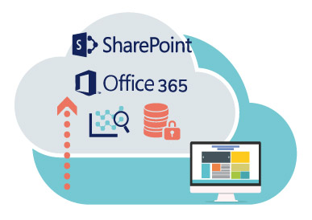
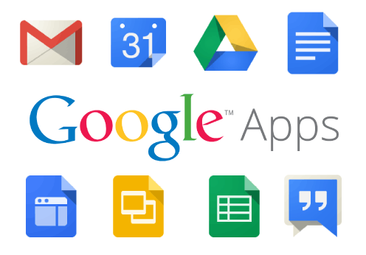
Software as a service (SaaS)
Applications that run on a server (web applications)
Notes:
SaaS is software that runs on the internet, on servers in the cloud. Office 365 and Google Apps are examples of SaaS.

Slide 25
Software as a service (SaaS)
Delivered as a service to the customer who can access the program from any online device
  Eliminates the need to install and run the application on the customer's own computers
  Simplifies maintenance and support
Notes:
Позиционируется как «программное обеспечение по требованию», которое развернуто на удаленных серверах и каждый пользователь может получать к нему доступ посредством Интернета, причем все вопросы обновления и лицензий на данное обеспечение регулируется поставщиком данной услуги.
Since the cloud-based software does not run directly on the device, it can be cross-platform or run on various platforms. You can access the same information on your mobile device and your laptop. A principal benefit of SaaS is it eliminates the need to install and run the application on the customer's own computer. For example, you do not need to install Google Drive on your computer to access your cloud documents. Another benefit is it simplifies maintenance and support for the developers. They only need to update and maintain the software running in the cloud instead of having to push software updates to all users.

Slide 26
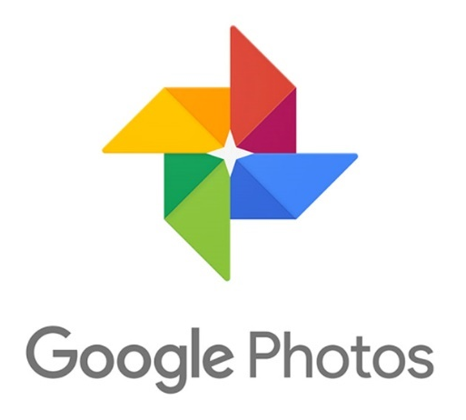

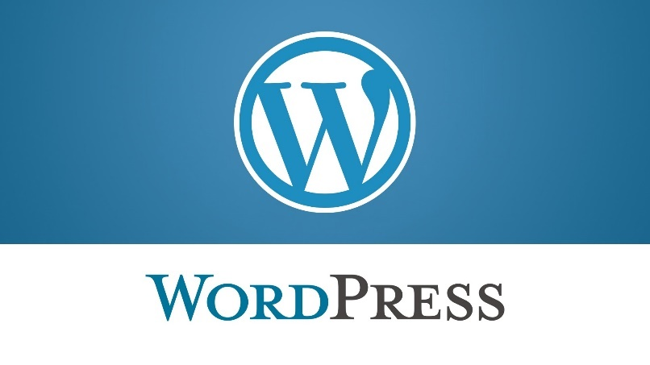
Who subscribes to or uses SaaS?
You do!
Any end-user who uses a web application uses SaaS
Notes:
So then, who subscribes to or uses SaaS? You do! Any end-user who uses a web application uses SaaS. You might use Google Photos to backup your images or connect with your friends on VK. You do not pay for most of the services, but most of the web apps that you use offer a premium package for more online storage or other feature.

Slide 27
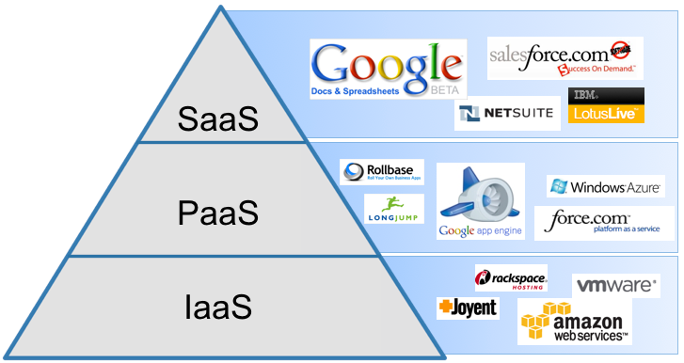
Commercial Cloud Providers
Notes:
This graphic shows some of the commercial cloud providers. Amazon Web Services and Rackspace offer infrastructure services. Google Apps Engine and Windows Azure offer platforms for developers. Software service providers are Google Apps and Salesforce.

Slide 28
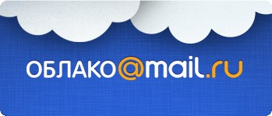
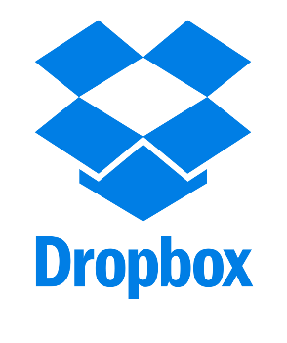
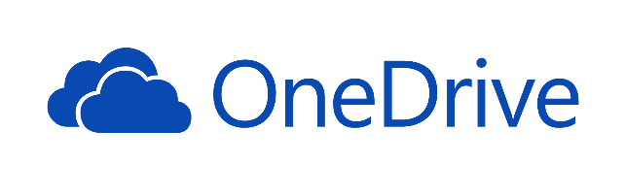
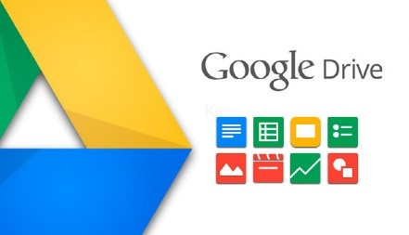
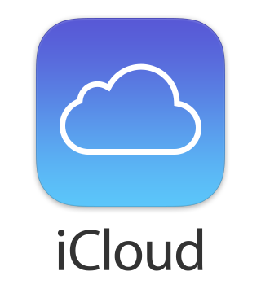
Cloud Storage Services
Dropbox
Google Drive
Yandex.Disk
Облако@mail.ru
iCloud and iCloud Drive
OneDrive
Notes:
There are many cloud storage services. Some common ones are Dropbox, Google Drive, Yandex.Disk, Облако@mail.ru, iCloud, and OneDrive. All of these services offer limited, but free usage. They offer additional storage space for a fee. For example, DropBox gives each user 2GB of free storage, OneDrive provides 5GB, Google Drive gives their users 15GB of storage for Gmail and Drive files.

Slide 29
Cloud Computing Characteristics
Common characteristics:
Scalability
Resilient Computing
Homogeneity
Geographic Distribution
Virtualization
Service Orientation
Low Cost Software
Advanced Security
Essential characteristics:
On-demand Self-Service
Broad Network Access
Rapid Elasticity
Resource Pooling
Measured Service
Notes:
Cloud computing has specific characteristics, such as scalability, resiliency, virtualization, and service orientation.
Scalability allows the service to scale with usage to allow for traffic spikes.
Resiliency allows the service to operate under stress or to overcome unexpected events. Cloud providers mirror or duplicate systems and data to prevent data loss or minimize downtime.
Virtualization allows many subscribers to use the same hardware or to create their own virtual networks.
Many providers offer low-cost software, while others cater to high-end markets.
Some cloud computing providers operate in a localized market, such as only in Europe or China.
Others, offer various geographic locations in North America, Europe, and Asia.
One essential characteristic is on-demand self-service.
Regardless of the time or circumstance, a consumer can access their service.
Another essential component is rapid elasticity, which allows for the infrastructure to expand to meet the immediate demand.
For example, instead of a user having a fixed amount of hard drive space or memory, such as 100GB for storage and 8GB of RAM, the cloud platform automatically increases storage space or RAM on demand. The subscriber only pays for the amount they use.
Rapid elasticity is possible due to resource pooling.
All users share the resources. Unused resources on one server can be temporarily given to another user to meet the current demand.
Examples of resource sharing include storage, processing, memory, network bandwidth, and virtual machines.

Slide 30
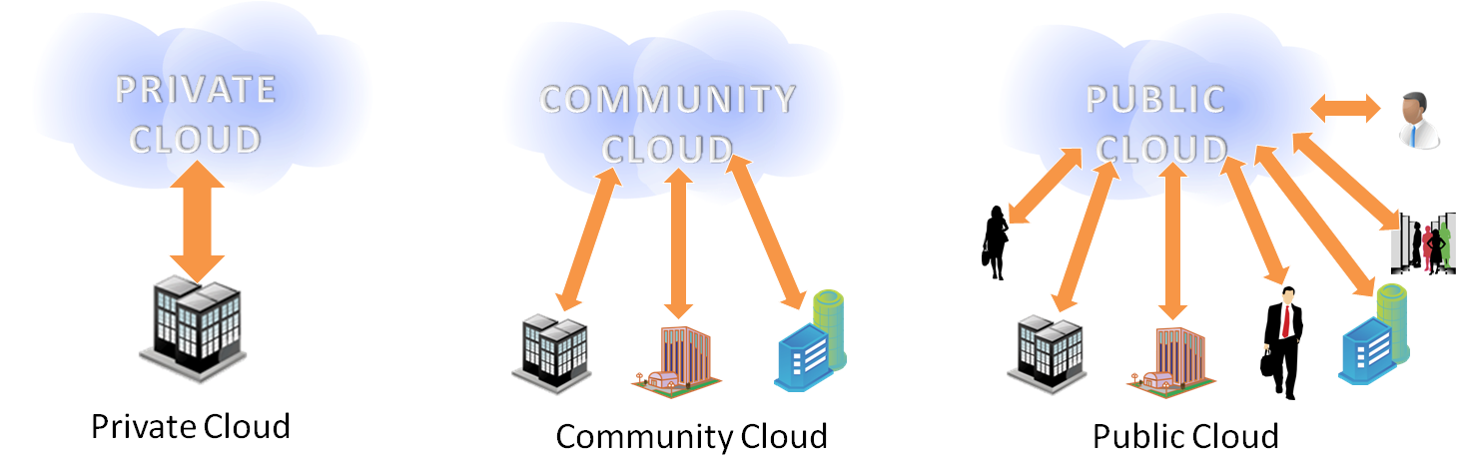
Deployment Models
Private cloud
Community cloud
Public cloud
Hybrid cloud
Notes:
There are different classifications of cloud deployment models, which include the public, private, community, and hybrid.
A private cloud is an organization that needs more control over their data than they can get by using a vendor-hosted service.
A community cloud infrastructure is deployed for use by a specific community of consumers that share a common interest. It is similar to a private cloud but has a broader audience.
Public cloud computing environments are open for use to anyone who wants to sign up and use them.
A hybrid cloud combines both public and private cloud models.

Slide 31
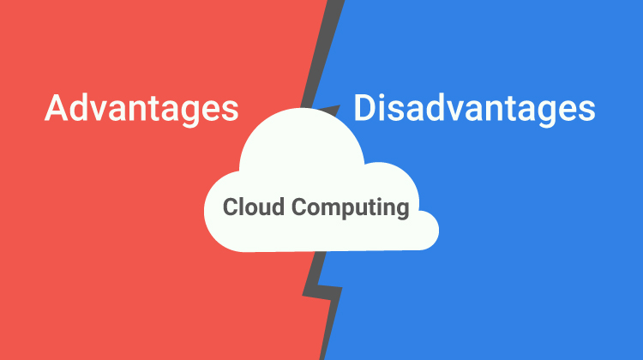
Advantages and Disadvantages
What might be some of the advantages or disadvantages of cloud computing?
Notes:
As with any computing model, there are advantages and disadvantages. Let’s explore some of these.

Slide 32
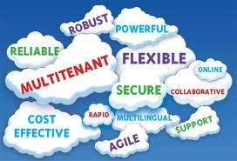
Advantages of Cloud Computing (1)
Lower computer costs
Improved performance
Reduced software cost
Instant software updates
Unlimited storage capacity
Notes:
As with any computing model, there are advantages and disadvantages. Let’s explore some of these.
Lower computer cost: One benefit is it lowers the cost of computers because the cloud servers can handle the processing power instead of purchasing high-powered computers
Improved performance: Cloud computing can access the processing power of many servers and increase data storage on-demand
Software: The user no longer has to update their applications since the always use the latest version

Slide 33
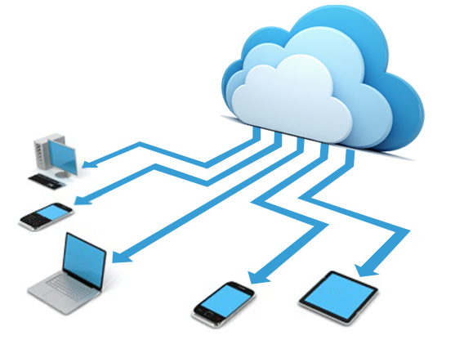
Advantages of Cloud Computing (2)
Increased data reliability
Universal document access
Device independence
Easier group collaboration
Notes:
As with any computing model, there are advantages and disadvantages. Let’s explore some of these.
Lower computer cost: One benefit is it lowers the cost of computers because the cloud servers can handle the processing power instead of purchasing high-powered computers
Improved performance: Cloud computing can access the processing power of many servers and increase data storage on-demand
Software: The user no longer has to update their applications since the always use the latest version
Increased data reliability: Another benefit is protection from a hard drive failure since the data is stored in the cloud
Document access and device independence: Cloud computing allows for universal document access on different devices
Collaboration: Another benefit is collaboratively working on a single document, such as building a Google Slide presentation.

Slide 34

Disadvantages of Cloud Computing
Requires an Internet connection
Does not work well with low-speed connections
Features might be limit
Stored data might not be secure
Notes:
Despite the benefits, cloud computing has disadvantages.
Firstly, it requires a fast internet connection. If your mobile device is out of coverage or is using the edge network, you might not be able to access your data.
Another disadvantage is that cloud applications usually have a limited feature set.
For example, Google Docs cannot do everything that Microsoft Word can.
Finally, storing your data in the cloud might not be secure. What if someone hacks the server? Could a rogue engineer steal your data? Does your cloud service provider encrypt your data to keep you protected? OneDrive, Google Drive, and Dropbox all encrypt your files during transit and on the servers. Not all cloud computing providers do that.

Slide 35
Cloud computing Summary
Cloud computing is internet-based computing
IaaS provides and manages the hardware
PaaS hosts an application or service
SaaS runs software in the cloud
Advantages: cost effective, data protection, device independent, and improved collaboration
Disadvantages: requires internet connection, limited features, and security
Notes:
In summary, cloud computing is internet-based computing.
Cloud computing is a service made up of the three separate services of software as a service (SaaS), platform as a service (PaaS), and infrastructure as a service (IaaS).
The internet infrastructure is comprised of resources that support the flow, storage, processing, and analysis of data.
IaaS provides and manages the infrastructure and other hardware for their subscribers.
A computing platform is an environment that executes or runs software.
PaaS is used to host an application or service on a cloud-based server.
SaaS is software that runs on the internet, on servers in the cloud.
A user might access the internet-based application through a web browser or using a mobile application.
Some advantages of cloud computing are cost-effective, data protection, device independence, and improved collaboration.

Slide 36
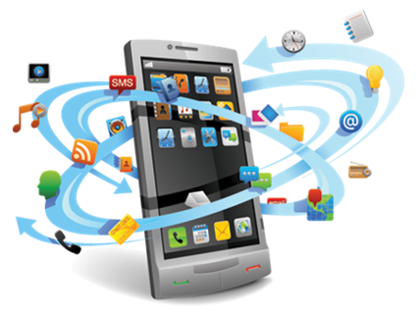
10.2. Mobile Cloud Computing
10.1. Cloud Computing
10.2. Mobile Cloud Computing
Notes:
During this video, we explore mobile cloud computing.

Slide 37
Learning Objectives
Define mobile technology
Explain how mobile devices communicate
Explain mobile cloud computing (MCC)
Describe advantages of MCC
Describe disadvantages of MCC
Notes:
Please take a moment to read the learning objectives for this video.

Slide 38
Mobile Technologies
Mobile technology is exactly what the name implies - technology that is portable and can communicate
Examples of mobile devices include
  laptops and tablets
  mobile phones and smartphones,
  global positioning system (GPS) devices,
  wireless debit/credit card payment terminals
Notes:
Mobile technology is what the name implies, which is technology that is portable and can communicate. Examples of mobile devices include mobile phones, laptops, tablets, or GPS devices.

Slide 39
Mobile Technology Communication
Mobile devices can be communicate in a variety of ways:
  Wireless fidelity (WiFi) – connects to a LAN
  Bluetooth – connects two mobile devices
  Cellular technologies
    Modern: 3G, H+, 4G
    Older: GSM, GPRS, Edge
Notes:
Mobile devices can communicate in a variety of ways, which include WiFi, Bluetooth, or using Cellular technologies. The conventional cellular technologies used today are 3G and 4G.

Slide 40
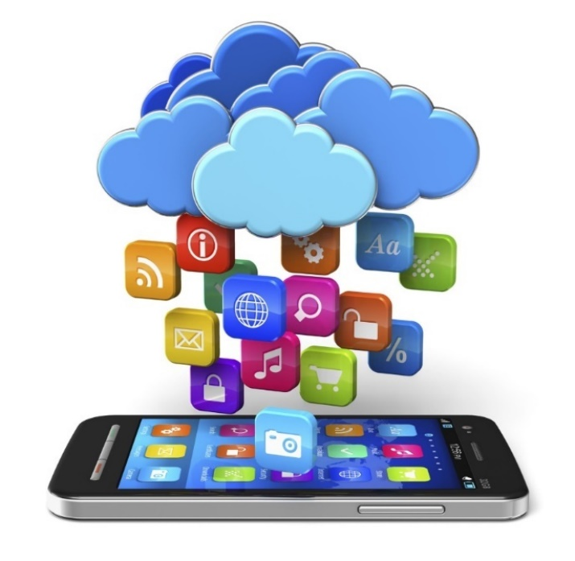
Essential to our lives
Mobile devices have become an essential part of human life.
We rely on
  Having access to information at our
  fingertips anywhere, anytime
  On-demand communication
Notes:
Mobile devices have become an essential part of human life. We rely on having access to information at our fingertips anywhere, anytime. Additionally, we are accustomed to having on-demand communication.

Slide 41
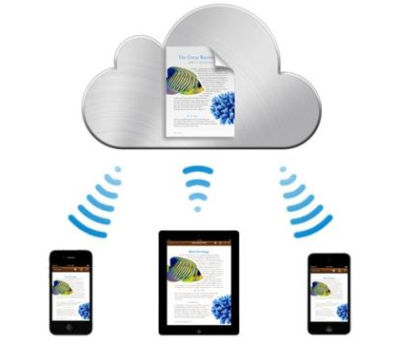
Mobile Cloud Computing (MCC)
Mobile Cloud Computing (MCC) is the combination of cloud computing, mobile computing, and wireless networks
MCC uses cloud computing to deliver
cloud services to mobile devices
Notes:
Mobile Cloud Computing (MCC) is the combination of cloud computing, mobile computing, and wireless networks. In short, MCC uses cloud computing to deliver cloud services to mobile devices.

Slide 42
Mobile Cloud Computing (MCC)
MCC is nothing new or different from how you currently use your mobile devices
Many of you are mobile-first users (you are more comfortable using a mobile device than a computer)
The point is to understand the technology from a mobile perspective
Notes:
MCC is nothing new or different from how you currently use your mobile devices. Many of you are mobile-first users, which means you are more comfortable using a touchscreen device than a computer with a keyboard. The point of learning about MCC is to understand the technology from a mobile perspective.

Slide 43
Mobile and Cloud Comparison
Mobile characteristics
Cloud characteristics
Ubiquitous and distributed
Portability of physical devices
Limited storage
Limited processing power
Limited bandwidth
Context-aware
Centralized
Portability of software
Scalable storage
Scalable processing power
Scalable bandwidth
Context unaware
Notes:
MCC combines the strengths of mobile and cloud computing. For example, mobile devices are ubiquitous and portable, but they lack storage and processing power. Cloud computing leverages their strengths of portability to provide access anytime. Mobile users do not need to worry about storage space on their phone if they use cloud computing to automatically backup large files, such as photos and videos. Google Photos, for example, automatically backups pictures to the cloud and can delete copies stored on the mobile device..

Slide 44
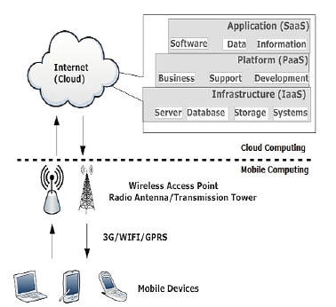
Network Division
Cloud computing
Mobile Network
Notes:
Mobile cloud computing at its simplest refers to an infrastructure where both the data storage and the data processing happen outside of the mobile device. This means that all data is sent to the cloud for processing. More commonly, some initial processing happens on the local device before being delivered to the cloud. Additionally, some data remains on the mobile device. Using services in MCC involve using both the mobile network and the cloud service.

Slide 45
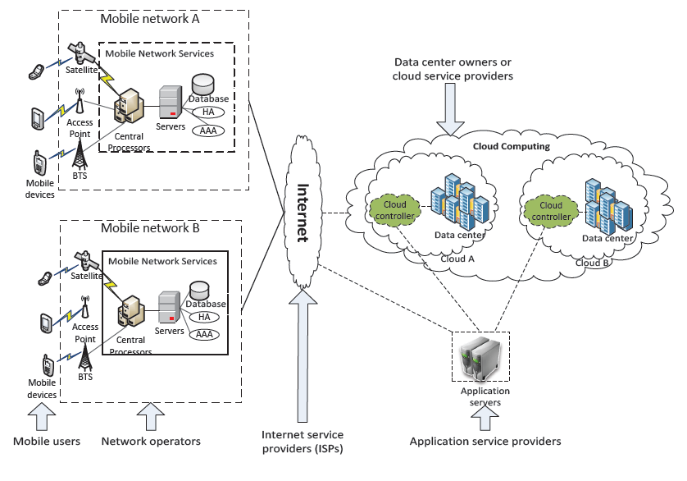
Mobile Cloud Computing
Notes:
This image shows a detailed look at the MCC infrastructure. The different components, which require an interface, are the mobile users, mobile network operators, ISPs, and then the application service providers. The only thing different from regular cloud computing is the mobile network operators, such as Beeline. In regular cloud computing, the user usually connects directly to the ISP.

Slide 46
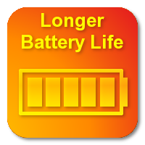
Advantages of MCC
Extending battery lifetime
Improving data storage capacity and processing power
Improving reliability
Notes:
Using MCC has some advantages.
One advantage is it can extend the battery of the mobile device by processing the data in the cloud.
Another is it improves the data storage on the mobile device by storing data in the cloud.
Additionally, MCC enhances reliability since the data and applications are backed up in the cloud, which protects against a lost or destroyed mobile device.

Slide 47


Issues of Mobile Communication
Network latency and limited bandwidth
Network Availability
Security risks
Notes:
However, there are some downsides to accessing cloud data using a mobile device. These issues include network latency and limited bandwidth, network availability, and security risks.

Slide 48
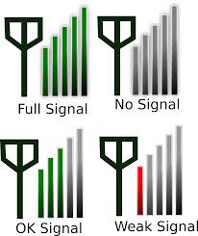
Issues (1): Network Availability
Mobile users may not be able to connect to the cloud to obtain service due to
  traffic congestion
  network failures
  out-of-signal
Notes:
Because MCC requires an internet connection, a mobile device will not be able to access the cloud data when outside of the normal operating range. For example, if the user is traveling through an area with spotty or limited cellular coverage, they cannot access their data.

Slide 49
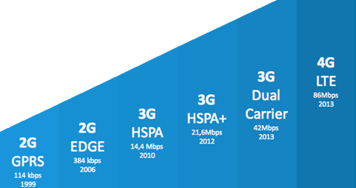
Issues (2): Network Limitations
Mobile cloud computing faces challenges from how wireless networks
and devices operate
Notes:
MCC users face other issues, such as low bandwidth or high latency. Latency is how long it takes the data to get to the server and then back to the device. If the latency is too high, then the server will drop the TCP connection, which results in a connection-timed-out error. If a user is trying to access cloud data using low bandwidth, then the service will be degraded or unavailable if it is not designed to work with low bandwidth. Video streaming is an example of a cloud service that will not work with low bandwidth.

Slide 50

Issues (3): Security Risks
Security for mobile users
  Security for mobile applications
  Privacy
Security of data in the cloud
  Authentication
Notes:
A final issue that MCC users face is security. Not only are they concerned about their cloud data, but they must secure their mobile devices. MCC users often stay logged into their accounts on their mobile device, which means that anyone who accesses the mobile device can also access the cloud data. MCC users need to take care to lock and secure their devices.

Slide 51
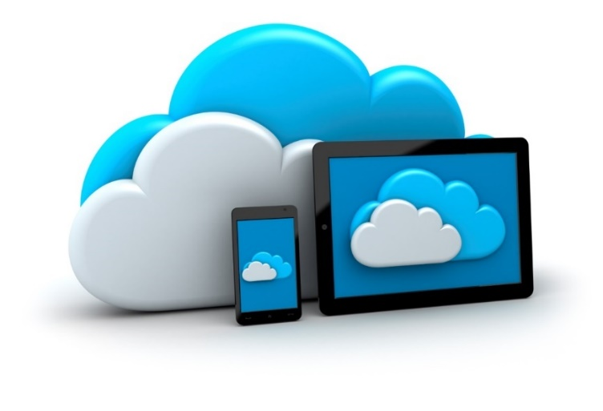
MCC Growth
MCC continues to grow in popularity due to many factors, which include:
  A focus on mobile technologies
    Mobile-first websites
    Mobile apps based on cloud data
  Better smartphones
    faster, lighter, longer battery life, more efficient to use
  Enhanced mobile coverage and speeds
Notes:
MCC has grown substantially with the increase of mobile devices.
The internet is moving to a mobile-preferred platform away from preference on desktop computers.
A primary factor is a convenience of using a mobile device to access web data or internet services on the go instead of waiting to access a desktop computer.
The focus on mobile technologies drives development and many aspects of mobile computing
For example, websites and cloud servers cater to mobile users first and then desktop users second.
This move to mobile computing is possible because of technology improvements in both the smartphone hardware and cellular technologies.
The flagship smartphones are faster, lighter, have longer battery life, and are more efficient to use than their predecessors.
Cellular technologies continue to enhance mobile coverage and bandwidth, so mobile users experience fewer places without data coverage
Data transfer speeds have increased from 3G to 4G technologies. Soon, some markets will have 5G!

Slide 52
Mobile Cloud Computing Summary
Mobile technology is technology that is portable
Mobile devices communicate using WiFi, Bluetooth, or cellular technologies
Mobile Cloud Computing (MCC) is the combination of cloud computing and mobile computing
MCC advantages include saving battery consumption, processing power, and storage space
MCC disadvantages include limited bandwidth, network availability, and security risks
Notes:
In summary, mobile technology is technology that is portable.
Examples of mobile devices are laptops, tablets, and mobile phones.
Mobile devices primarily communicate using WiFi, Bluetooth, or cellular technologies.
Mobile Cloud Computing (MCC) is the combination of cloud computing, mobile computing, and wireless networks.
In short, MCC uses cloud computing to deliver cloud services to mobile devices.
MCC combines the strengths of mobile and cloud computing, which uses the mobile device for portability and cloud computing for processing and storing data.
MCC has some key advantages over processing the data on the device itself.
It saves battery consumption, processing power, and storage space by leveraging the benefits of cloud computing.
However, there are some downsides to accessing cloud data using a mobile device because cloud computing requires the use of the internet.
These issues include limited bandwidth, network availability, and security risks.

