Slide 1


13. E-services

Slide 2

Copyright Notice
This presentation is presented as is. This presentation was assembled using information from various websites or sources across the web.
This presentation uses Creative Commons Attribution 4.0 International (CC BY 4.0). © 2019 BilimEdtech

Slide 3
13.1. E-services
13.1. E-services
13.2. E-commerce
13.3. E-learning
13.4. E-government

Slide 4
E-services Learning Objectives
Define e-service
Describe the three requirements of an e-service
List examples of e-services
Notes:
In summary, …

Slide 5

Describing E-services
E-service is short for electronic service
Services for consumers (business or individual) using ICTs
Services require a transaction to occur

Slide 6
E-services Components
Three main requirements
  Service provider
  Service receiver
  Service delivery channel (i.e., technology)
Automated
  Not required, but many e-services are fully automated

Slide 7
Component (1): Service Provider
An agency or office that provides some service for profit or for free
  Postal system – Sending and receiving of parcels
  Print services – Copying or printing documents
  Commerce – Buying or selling products
  Banking System – Accessing or transferring funds
  Travel Agency – Buying tickets or tour packages

Slide 8

Component (2): Service Receiver
Anyone who uses the service
  Businesses
  Individuals

Slide 9

Component (3): Service Delivery
The method of how the provider delivers the service
  Internet (most commonly)
  Cellular technologies
  Kiosk/pay terminal
  Call center

Slide 10
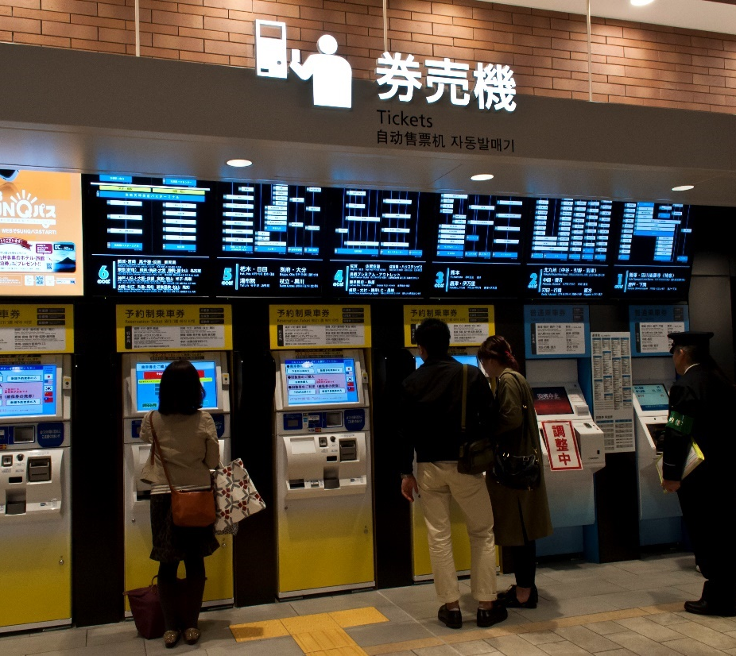
Component (4): Automated
The service is usually automated
Allows the consumer to use the service with minimal or no human intervention
  i.e., purchasing a ticket

Slide 11

Examples
Virtual Services
Physical Services
Streaming music or movies
E-books
Cloud computing
Online or downloaded games
Metro/bus ticket
Online commerce
Pay and manage utility bills

Slide 12
13.2. E-commerce
13.1. E-services
13.2. E-commerce
13.3. E-learning
13.4. E-government

Slide 13
E-commerce Learning Objectives
Define e-commerce
Explain the e-commerce procedure
List the categories of e-commerce
Describe the advantages and disadvantage of e-commerce
Notes:
In summary, …

Slide 14

Defining E-commerce
E-Commerce or electronic commerce is a process of buying, selling, transferring, or exchanging products, services, or information using ICTs.
E-business is another
word for e-commerce

Slide 15

Defining Commerce
The exchange of goods and services for money
  Buyers – those with money who want to purchase a good or service
  Sellers – those who offer goods and services to buyers
  Producers – those who create the products and services that sellers offer to buyers

Slide 16
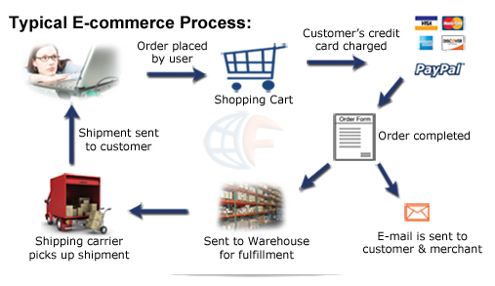
E-commerce Process

Slide 17
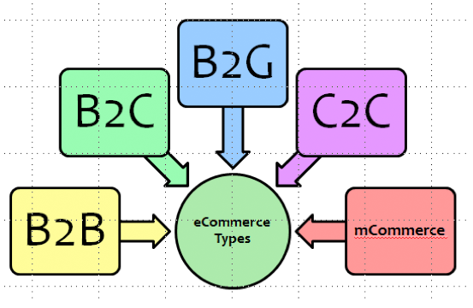
Categories of E-commerce (1)
Business-to-business (B2B)
Business-to-consumer (B2C)
Business-to-government (B2G)
Consumer-to-consumer (C2C)
Government to consumer (G2C)
Government-to-business (G2B)

Slide 18
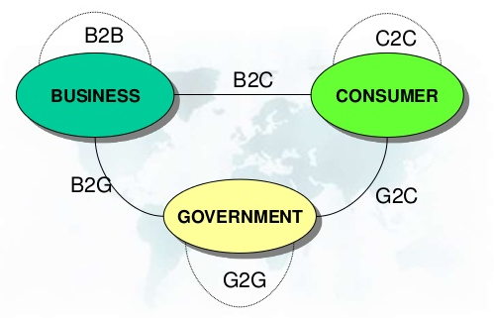
Categories of E-commerce (2)

Slide 19
Advantages of E-commerce
Buying/selling 24/7 from a computer
Not limited to a geographical location
  Businesses have a broader reach to customers
  Customers have a larger selection
Easier to find uncommon or special products
Low operational costs without a physical storefront
Easy to start and manage a business

Slide 20
Disadvantages of E-commerce
Unable to examine products personally
Rely on other customer reviews of products
Requires a way to transfer money electronically
Possibility of credit card number theft
Receive defective product
Slow delivery
Difficult to return products

Slide 21

13.3. E-learning
13.1. E-services
13.2. E-commerce
13.3. E-learning
13.4. E-government

Slide 22
E-learning Learning Objectives
Define the term elearning
List the benefit of elearning
Describe the difference between asynchronous and synchronous learning
Explain the blended and online learning
List types of elearning tools
Notes:
In summary, …

Slide 23

What is elearning? (1)
Elearning is intentional learning over the internet
  Uses educational psychology and instructional design
  Thoughtful integration
  Interactive
  Synonymous with online learning
  Evolves with technology

Slide 24

What is elearning? (2)
Elearning facilitates and supports learning through the use of information and communications technology
  Learning is the key component to elearning
  Elearning describes how students learn using technology

Slide 25
Benefits of Elearning
Engages learners who have difficulty attending face-to-face lectures
  Live far away; work during class hours; taking care of a sick family member or kids; disabled
Different learning modes for those who struggle with lectures
  Low language, ineffective listening skills, writing disability
Interactive learning continues outside of the classroom

Slide 26
Modes of Elearning
Synchronous
  Elearning sessions that happen in real time
  Not as common in elearning
Asynchronous
  Elearning happens over a duration (e.g., a week)
  Commonly used in elearning

Slide 27
Synchronous Elearning
Synchronous learning activities are chat conversations and audio/video conferencing
Real-time interaction between student and instructor

Slide 28
Asynchronous Elearning
Asynchronous events are time‑independent
Usually students are interacting and learning together using an online tool
  Learning material and then discussing in a forum
  Creating a class wiki
  Developing an online presentation to share knowledge

Slide 29
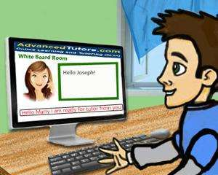





Examples
Synchronous
Asynchronous

Slide 30


Limitations
Synchronous
Asynchronous
Technology may not work
Students have to meet at a fixed time
Students feel isolated
Requires self-motivation

Slide 31
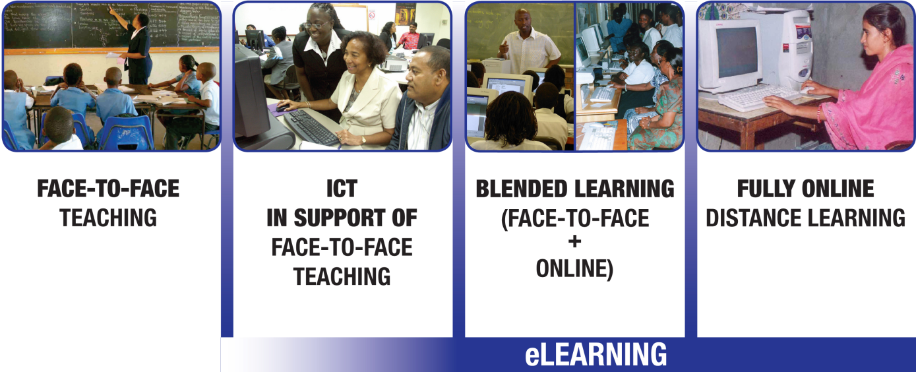
Elearning Categories
Elearning covers a range of activities
Most fall into these categories
  (1) Blended learning; (2) Fully-online learning

Slide 32
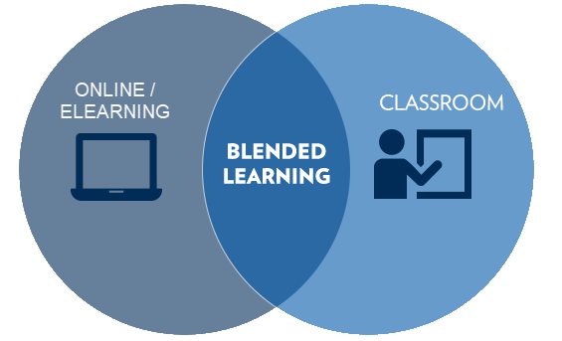
Blended Learning
Blended learning is classroom learning combined with online learning
Takes the best of
both formats

Slide 33

Blended Learning Examples
Students acquire knowledge at home. During class, they discuss, apply, or demonstrate the learned material
Discuss material online through a forum
Work on a collaborative online project

Slide 34
Fully Online Learning
Formal education that takes place entirely only
Students do not attend face-to-face lectures
May use synchronous or asynchronous technology
Students learn and apply knowledge online
Usually more work and more interactive than classes in traditional education

Slide 35
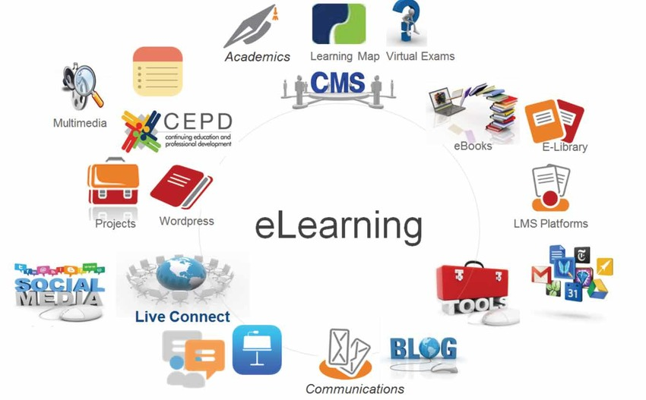
Elearning Tools
Learning Management System (LMS)
Web conferencing software
Web-based discussion tools
Collaborative learning tools

Slide 36
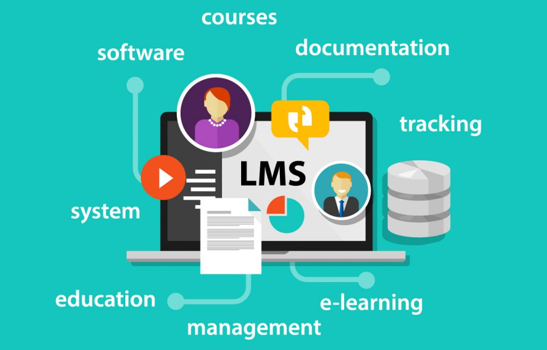
Learning Management System (LMS)
All-in-one online course platform that includes the essential tools for teaching and learning online
  Administrative features
  Asynchronous
  Synchronous
  Blended learning
  Fully online

Slide 37
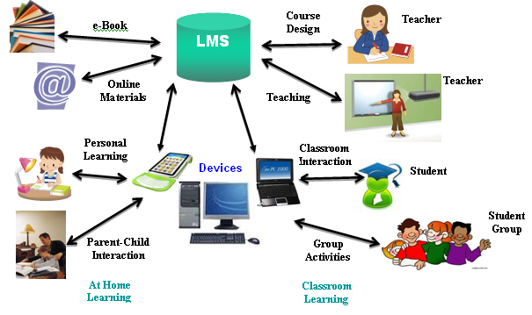

Slide 38

Web conferencing software
Allows the instructor and students to have live learning sessions online
  Audio/video/chat
  One-to-one
  One-to-many

Slide 39
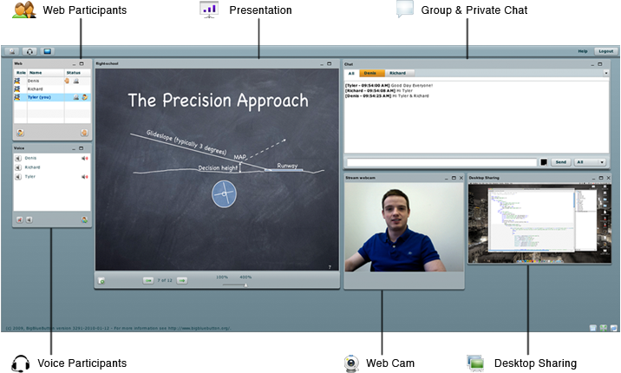

Slide 40
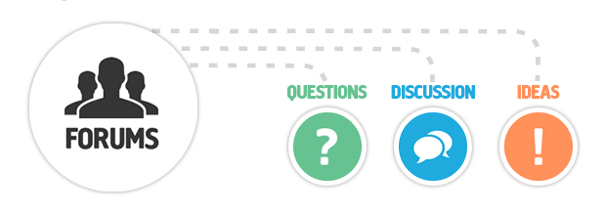
Web-based Discussion Tools
Allows students and teachers to interact online
  Real-time chat sessions (synchronous)
  Forums (asynchronous, group learning)
  Blogs (asynchronous, individual learning)

Slide 41

Online Collaborative Learning Tools
Online tools that allow students to work together to create content
  Writing projects
  Spreadsheets
  Presentations
  Multimedia
  Programming
  Wikis

Slide 42
E-learning Summary
Elearning facilitates and supports learning using ICT
Reaches learners who cannot attend classroom learning
Synchronous learning happens in real time
Asynchronous learning happens over a duration
Fully online learning takes place entirely online
Blended learning combines online and classroom learning
Some elearning tools
  LMSs, web conferencing software, web-based discussion tools, and collaborative learning tools
Notes:
In summary, …

Slide 43

13.4. E-government
13.1. E-services
13.2. E-commerce
13.3. E-learning
13.4. E-government
Notes:
https://en.wikipedia.org/wiki/E-government

Slide 44
E-government Learning Objectives
Define e-government
List the interactions of e-government
Describe the e-government functions
Notes:
In summary, …

Slide 45
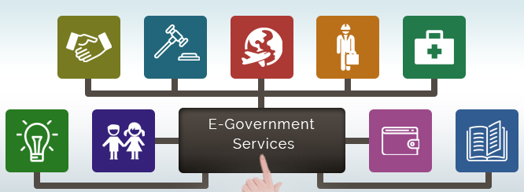
Defining E-government
E-government (short for electronic government) is the use of ICTs to provide public services to citizens and other persons in a country or region.

Slide 46
E-government Interactions
Between a citizen and their government (C2G)
Between governments and other government agencies (G2G)
Between government and citizens (G2C)
Between government and employees (G2E)
Between government and businesses (G2B)

Slide 47
E-government Functions (1)
Pushing information over the internet
  Making information available online
Two-way communications between the agency and user
  Users can engage in dialogue with agencies and post problems, comments, or requests to the agency
  Ability to interactively access and exchange information with the system

Slide 48
E-government Functions (2)
Conducting transactions
  Accessing or paying taxes, applying for services and grants, document renewal, etc.
Governance
  To enable the citizen transition from passive information access to active citizen participation by:
    (1) informing the citizen; (2) representing the citizen;
    (3) encouraging the citizen to vote; (4) consulting the citizen;
    (5) involving the citizen

Slide 49

Primary Goals (1)
E-government systems should aim to:
  (1) Improve the quality,
  cost, accessibility, and
  speed of delivering
  government information
  and services.

Slide 50
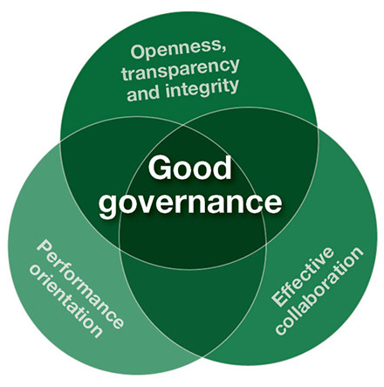
Primary Goals (2)
E-government systems should aim to:
  (2) Make government more accountable
  by increasing the opportunity for
  citizen participation in the
  governance process and bringing
  citizens closer to elected officials
  and public servants.

Slide 51

Primary Goals (3)
E-government systems should aim to:
  (3) Organize the production and distribution of public
  information and services in new ways, that is, to
  transform government services to meet citizens’ needs
  in an automated world.

Slide 52
E-government Advantages
More services offered to citizens more cheaply
Citizens can perform much of the work online
  E.g., Visit office for certain things, such as document verification for a name change after marriage
Government transparency
Increases citizen participation
  E.g., Voter awareness and participation in elections
Notes:
The ultimate goal of the e-government is to be able to offer an increased portfolio of public services to citizens in an efficient and cost effective manner. E-government allows for government transparency. Government transparency is important because it allows the public to be informed about what the government is working on as well as the policies they are trying to implement. Simple tasks may be easier to perform through electronic government access. Many changes, such as marital status or address changes can be a long process and take a lot of paper work for citizens. E-government allows these tasks to be performed efficiently with more convenience to individuals. E-government is an easy way for the public to be more involved in political campaigns. It could increase voter awareness, which could lead to an increase in citizen participation in elections. It is convenient and cost-effective for businesses, and the public benefits by getting easy access to the most current information available without having to spend time, energy and money to get it.
E-government helps simplify processes and makes government information more easily accessible for public sector agencies and citizens.

Slide 53
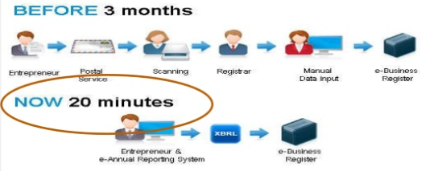
Example of an Improved Process

Slide 54
E-government Disadvantages
Lack of equality in public access to computers and the internet
  Some citizens can’t access a government service
Distrust of government
  System failure leads to distrust of the government
  Makes it easier for governments to track their citizens
Cost
  Cost is shifted from working with the citizens to maintaining the system for the citizens

