Slide 1


14. IT in the professional sphere

Slide 2

Copyright Notice
This presentation is presented as is. This presentation was assembled using information from various websites or sources across the web.
This presentation uses Creative Commons Attribution 4.0 International (CC BY 4.0). © 2019 BilimEdtech

Slide 3
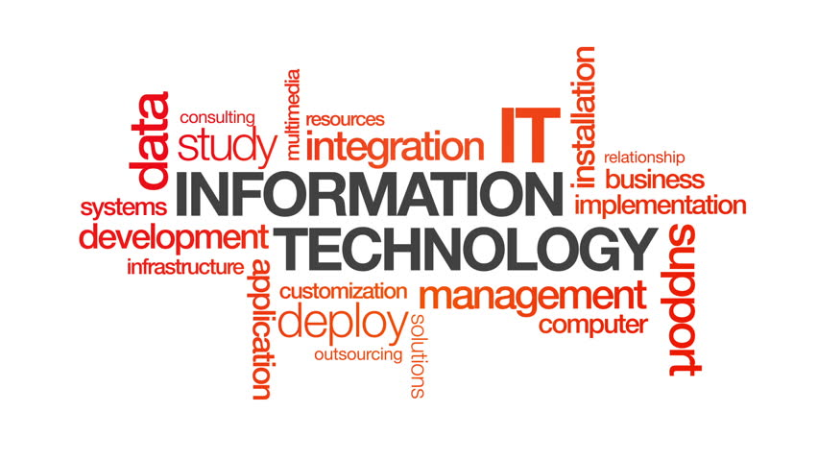
14.1. Defining IT
14.1. Defining IT
14.2. Importance of IT

Slide 4
What is IT? (1)
Information Technology (IT) is often misunderstood
  People use IT as a generic term to refer to various kinds of computer-related work
  IT has become a catch-all phrase for any job that works with computers
  Some consider software developers to be IT workers while others consider them engineers

Slide 5
What is IT? (2)
Information technology (IT) is the use of computers to store, retrieve, transmit, and manipulate data, or information, often in the context of a business or other enterprise.
IT is considered to be a subset of information and communications technology (ICT).

Slide 6
Distinguishing IT from ICT
IT and ICT have many similarities
  ICT is a European term that is often synonymous with IT
  North America and Asia favor the term IT
IT focuses on information (storing, transmitting, etc.)
  IT assumes communication
ICT focuses on the communication aspect using telecommunications

Slide 7
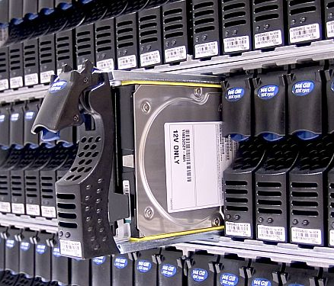
IT Characteristic (1): Data Storage
Stored information is data
  Stored on various physical media, such as hard drives
IT stores the data in an organized manner
  Databases
  Filesystems

Slide 8

IT Characteristic (2): Data Retrieval
Retrieving data on demand
Languages, such as SQL retrieve specific data from databases
Meaningful data becomes information

Slide 9
IT Characteristic (3): Data Transmission
Data transmission has three aspects
  Transmission – Sending data
  Propagation – Distributing data from one data source to other data sources
    Data is not all stored in the same location
    The same data is accessible in various locations
  Reception – Receiving data

Slide 10
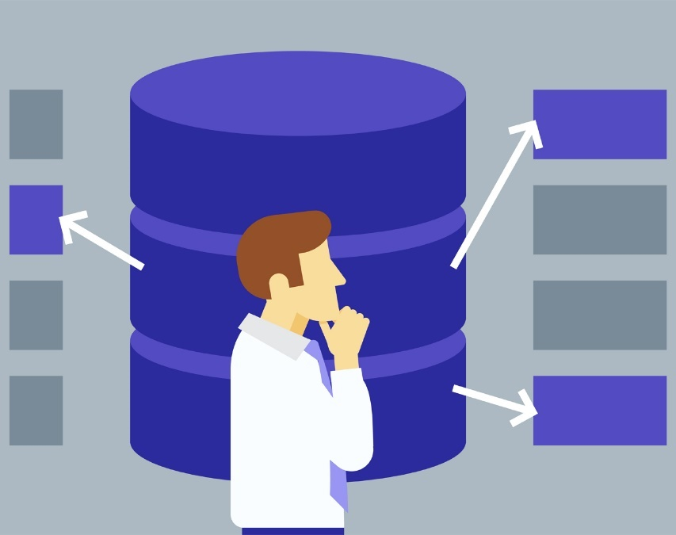
IT Characteristic (4): Data Manipulation
The process of changing data to make it easier to read or better organized.
  Sorting data alphabetically
  Summarizing data
  Generating reports with specific data

Slide 11
What do you think?
Is IT a subset of ICT?
  Does IT have a lesser focus on communication?
Does ICT extend IT by adding a telecommunication component?
  Does ICT have a lesser focus on information?
Are they the same thing just different terms?
Or, are the two fields different?

Slide 12
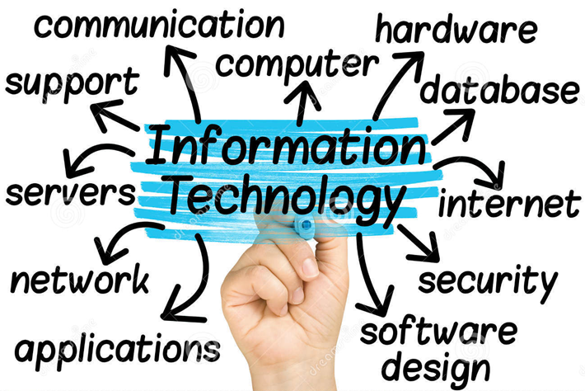
IT Work
Those who work in IT:
  Manage the systems required for organizations, businesses, or clients to store, retrieve, transmit, and manipulate data.

Slide 13

IT Department Primary Job
To keep the company or organization running
Companies are built on IT infrastructure
  Networks, servers, computers, software, etc.
Notes:
An entire company is built on the infrastructure that the IT department builds and maintains. This includes all of the physical components that keep a company running, like the server hardware and employee devices, as well as the network that your company operates on. It only takes one weak point in the infrastructure to send everything crashing down, and the IT department focuses on finding and strengthening those weak points.

Slide 14
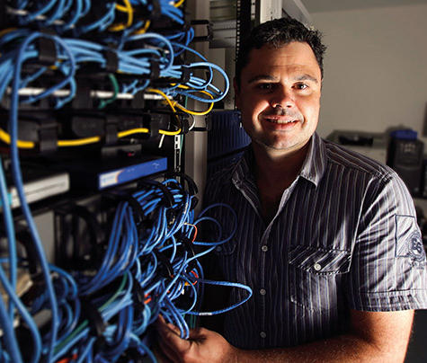
IT Department Core Functions
Stores the data
Protects the data
Provides technical support
Ensures connectivity
Keeps technology current in the organization
And many more…
Notes:
An entire company is built on the infrastructure that the IT department builds and maintains. This includes all of the physical components that keep a company running, like the server hardware and employee devices, as well as the network that your company operates on. It only takes one weak point in the infrastructure to send everything crashing down, and the IT department focuses on finding and strengthening those weak points.

Slide 15
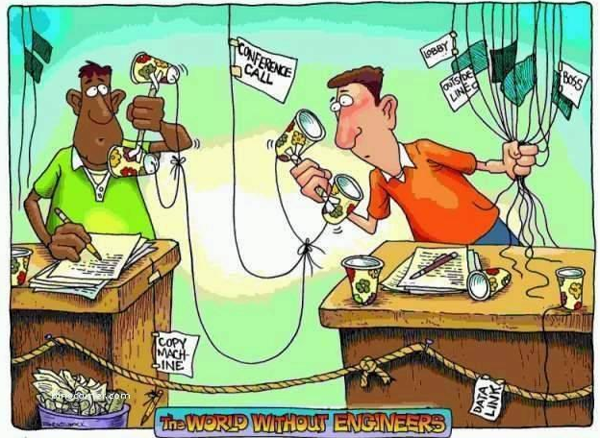
14.2. Importance of IT
14.1. Defining IT
14.2. Importance of IT

Slide 16

Many Sectors Rely on IT
Many sectors are built around
information technology.
Even if information is not a sector’s primary business (e.g., construction, transportation, delivery, beauty, etc.), they still need to work with their business information (e.g., client data, finance).

Slide 17
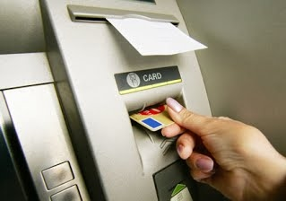
The Importance of IT
Information technology is vital to many sectors and professions
  Business
  Education
  Finance
  Healthcare

Slide 18
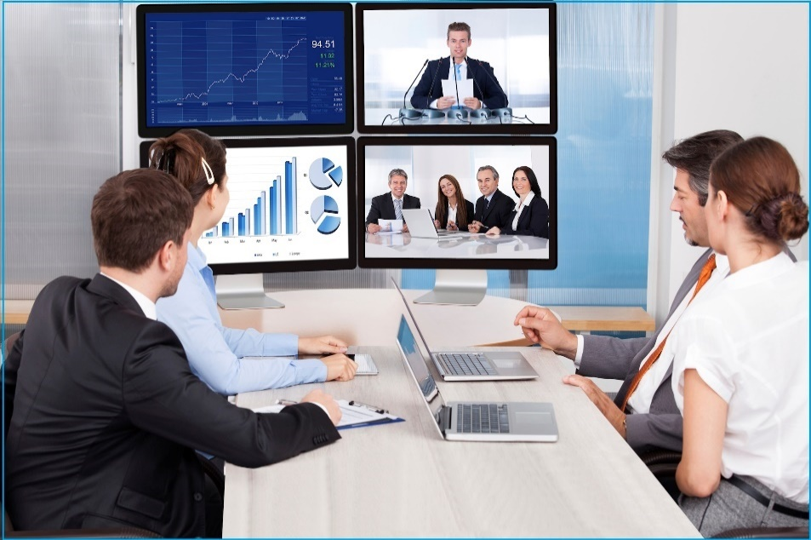
Importance of IT in Business (1)
Companies use information technology to ensure that their business operations run smoothly.
  Computers, business software, networks, etc.

Slide 19
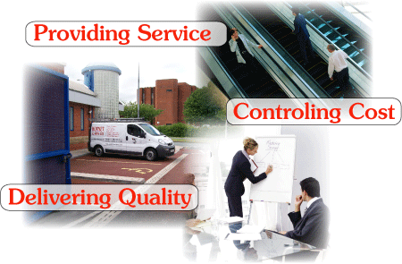
Importance of IT in Business (2)
Businesses use information technology in different departments, such as human resources, finance, manufacturing, and security.

Slide 20
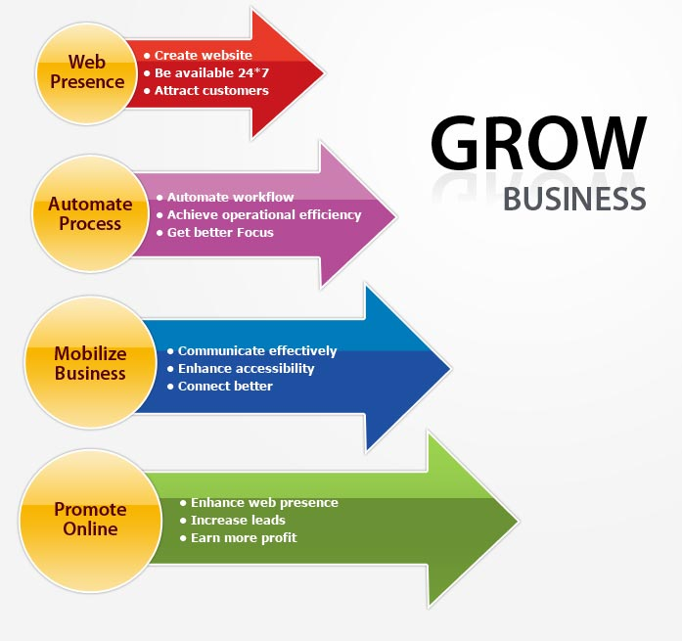
Uses of IT in Business
Help keep up with supply and demand
Financial transactions
Knowledge about markets and customers
Connecting with customers

Slide 21
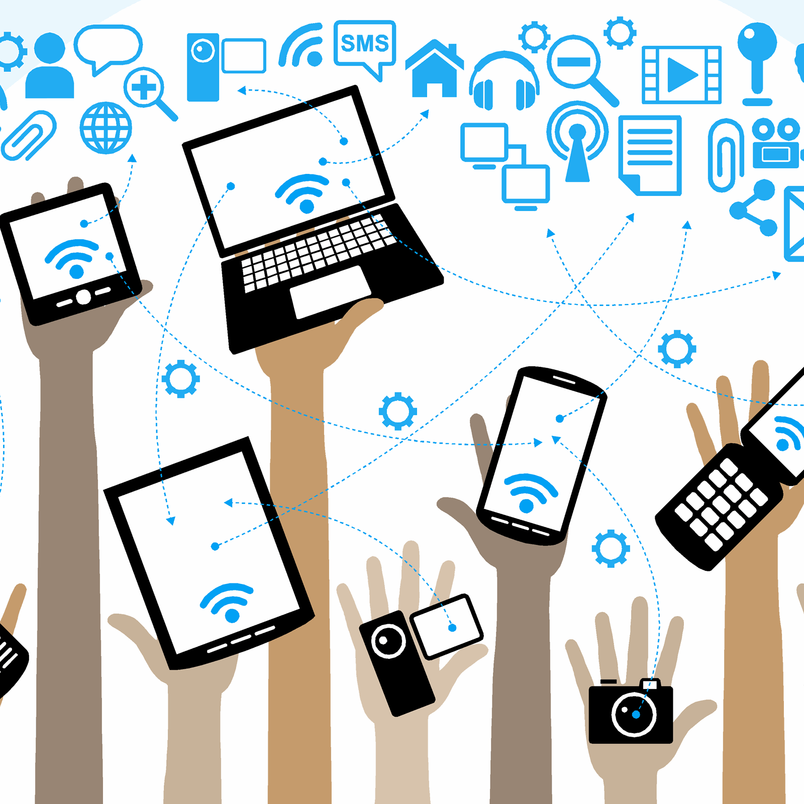
Importance of IT in Education (1)
We live in a changing world with a reliance on IT.
  Using IT for teaching and learning keeps education relevant to the workforce and equips students with IT-related skills.

Slide 22
Importance of IT in Education (2)
IT is important in education because it
  Improves skills, such as problem solving and self-learning
  Increases collaboration and interaction
    Students can work together easier using cloud computing
  Increases access to information through digital resources
  Opens up new ways of teaching and learning

Slide 23
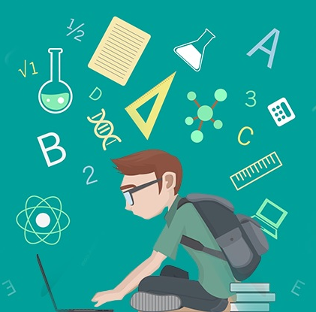
Uses of IT in Education
Online learning
Collaborative learning
Learn using cloud computing
Access to online resources
Student records
Online grades

Slide 24

Importance of IT in Finance (1)
Banks are an essential industry in our world
All other industries rely on the electronic services of the financial sector

Slide 25

Importance of IT in Finance (2)
Information technology makes it possible to manage and transfer money electronically
Today’s economies are based on the seamless and electronic transfer of money

Slide 26
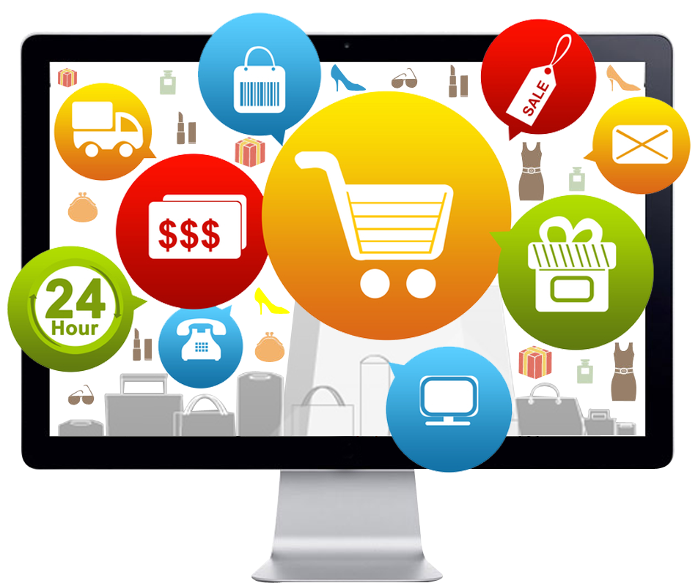
Uses of IT in Finance
Electronic payment of goods
Electronic transfer of money
Borrowing or lending funds
Online commerce
Adds security to financial transactions

Slide 27
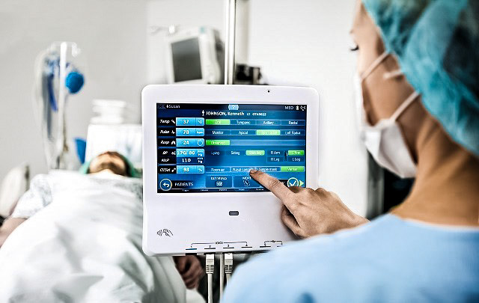
Importance of IT in Healthcare (1)
Improves the quality of healthcare delivery, increases patient safety, decreases medical errors, and strengthens the interaction between patients and healthcare providers.

Slide 28
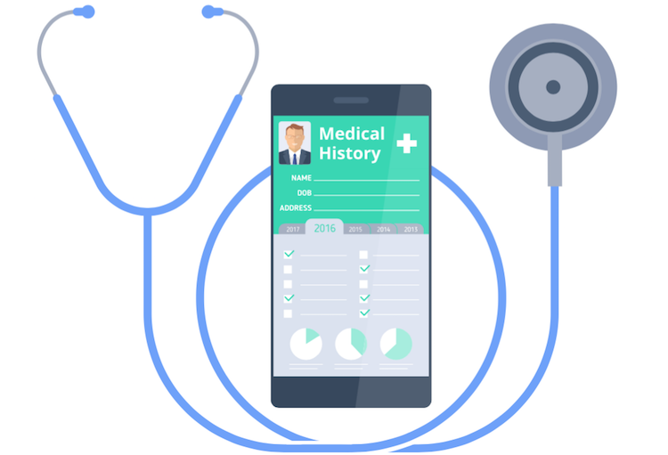
Importance of IT in Healthcare (2)
Improves hospital efficiency by accessing electronic medical records
Provide better care for patients by knowing the patient’s medical history

Slide 29
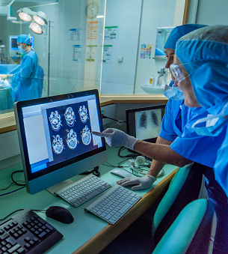
Uses of IT in Healthcare
Universal access to patient records
Medical staff have access to latest research on how to diagnose and treat patients
Computerized analysis and reporting
Storing digital imaging (MRI)
Artificial Intelligence

