Slide 1


INFORMATION AND COMMUNICATION TECHNOLOGIES
Data analysis. Data management

Slide 2
What is Data mining?
Data mining is a process of performing automated extraction and generating predictive information from large data banks.

Slide 3
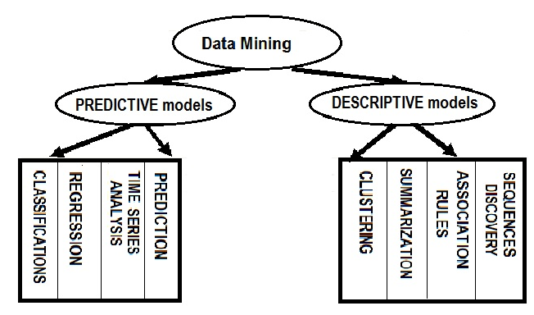
The basic Data mining models and tasks
DM involves many different algorithms to accomplish different task. All these algorithms attempt to fit a model to the data. The model that is created can be either predictive or descriptive in nature. Figure represents the main DM tasks used by that type of model.

Slide 4
The basic Data mining models and tasks
Predictive model enables to predict the values of data by using known results from different sets of sample data.
Classification enables to classify data from a large data bank into predefined set of classes.
Regression is one of statistical techniques which enable to forecast future data values based on the present and past data values.
Time series analysis is a part of Temporal mining enabling to predict future values for the current set of values which are time dependent. Time series analysis makes to use current and past sample data to predict the future values.

Slide 5
The basic Data mining models and tasks
Essence of a descriptive models is determination of the pattern and relationships in a sample data
Clustering is a data processing in some sense opposite to classifications which enables you to create new groups and classes based on the study of patterns and relationship between values of data in a data bank.
Summarization is a technique which enables to summarize a large chunk of data contained in a Web page or a document. It is also known as characterization or generalization.
Association rules enable to establish association and relationships between large unclassified data items based on certain attributes and characteristics.

Slide 6
Techniques often used for data mining
1
Statistics is one of largest branches of mathematics which deals with the collection and analysis of numerical data by using various methods and techniques
2
Decision Trees: a tree-shaped structure which represents a predictive model. In a decision tree each branch of the tree represents a classification question while the leaves of the tree represent the partition of the classified information
3
Machine Learning: a process of generating a computer system that is capable to acquire data independently and integrate data to generate useful knowledge.
4
Hidden Markov Models: a model that enables to predict future actions taken in time series.
5
Artificial Neural Networks: the non-linear predictive models which use the concept of learning and training and closely resemble the structure of the biological neural networks.
6
Genetic Algorithms: a search algorithm that enables to locate optimal binary strings by processing an initial random of population of binary strings by performing operations such as artificial mutation, crossover and selection.
7
Meta Learning: a concept of combining the predictions made from multiple models of data mining and analyzing these predictions to formulate new and previously unknown prediction.

Slide 7
Techniques often used for data mining
Some of the statistical techniques that find its extensive usage in data mining are:
Point estimation: a process of calculating a single value from a given sample data using statistical techniques such as mean, variance, media and so on.
Bayesian techniques: a technique of classifying data items available in a data bank.
Correlation: a technique of determining the relationship between two or more different sets of data variables by measuring their values.
Data summarization: a process of providing summary information from a large data bank without studying and analyzing and every data elements in the data bank.
Testing a hypothesis: a technique of applying sample data to a hypothesis in order to prove or disprove the hypothesis
Regression: a technique of estimating the value of a continuous output data variable from some input data variables.

