Slide 1

Topic: Networks and telecommunications

Slide 2

Computer network
Computer network — this computers' networks' informational exchange provision which computers I telecommunicational devices' total. Computer networks'. basic activity – abolished ресурстанға manual availability provision to provide.

Slide 3
Telecommunications
(buckwheats'. tele – far, far, and Latin. withommunicatio – messages')- beltransmission and reception of any information at a distance via various electromagnetic systems (cable, fiber – optic channels, radio channels, and other channels of wired and wireless communication).

Slide 4
Classification of computer networks
Regional sign by;
Topology by (network architecture);
Toils. on management;
Broadcasts ways on the organization.

Slide 5
Grouping by geographical location
Local
At.collective
Regional
Global
Most often one combine into a category directs, then toils 3 a type of profit will be

Slide 6
Local network - comparative boundedly spaces (for example building) within computers, print emitters I other yes device group uniting communication network. Local network one one of allows you to interact with connected devices.
Collective network - this is local with the network in close contact, famous one the collective and several near it provides the building's territory.
Regional (regional) toils – provides a geographical area.
Internet – Worldwide network (information service Wide Web (WWW) - «world au»).
English- WAN (Wide Area Network).

Slide 7
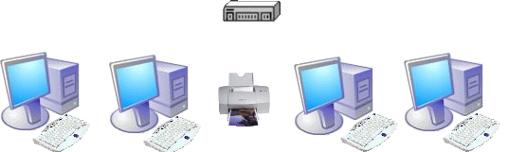
Peer network
All computer rights have one at the level. Any all from computer into the network join.

Slide 8
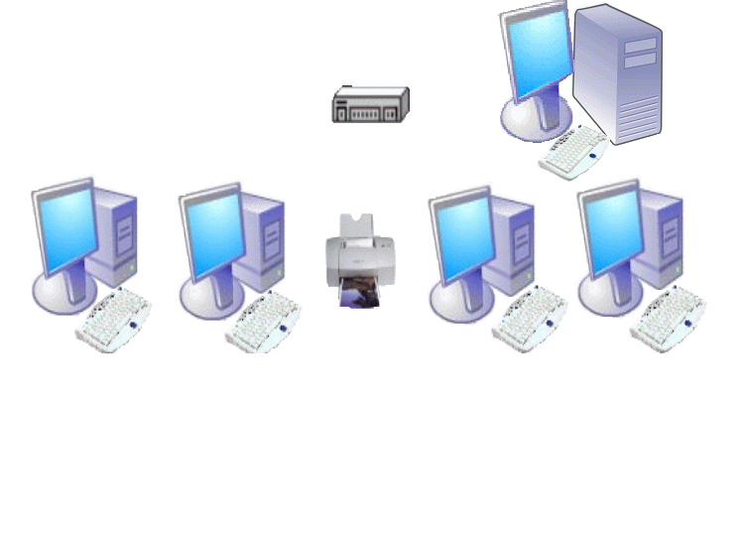
Installed server with the network
Server (English. server – structure maintenance)- computer, to the network of Fund users distribution.

Slide 9
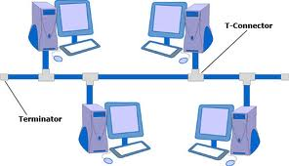
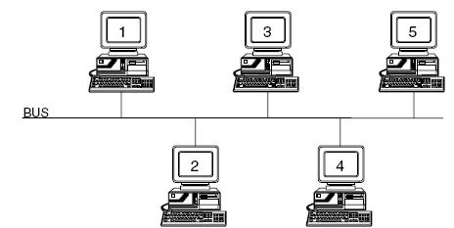
Topology by group
  Lines topology – merging ad networks in a geometric pattern..
«Shspines» topology
Information DTo network by apply to all, but his only only same relevant information EP accepts.

Slide 10
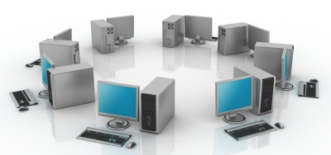
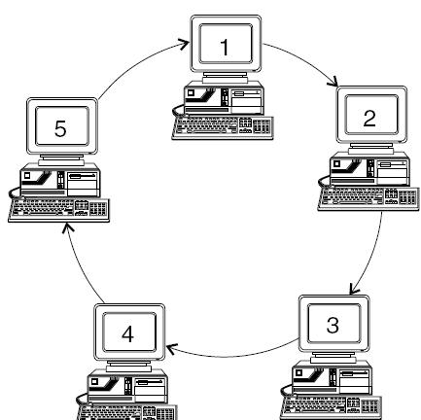
«Rings» topology
Information from the PC Turnover on the PC
as issues

Slide 11
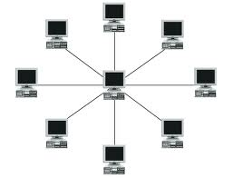
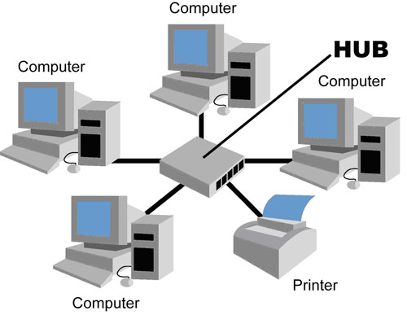
«Star» topology
whole PC it is included in the Central tuyinshekke.

Slide 12
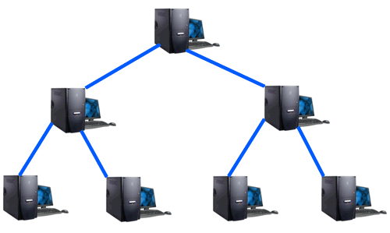
«Buthash» topology
Computer lines location of different layers can

Slide 13
Broadcasts Wednesday by group
Communication environment COMPUTER inside informations provision for, Ibox the characteristics of the interface COMPUTER with parameters agreement necessary, broadcasts network channel by. Technical structure, COMPUTER network channel by қабысуын функций, adapter or network adapter 1) names.
Physical transfer Wednesday LVS three cable with views:
screw couple
coaxial cable
optical fiber cable

Slide 14

Steam screw
    Steam screw two interconnected systems alone from the gas pipelines consists of;
    Scroll through guides electromagnetic flow paths to the outside signaling influence;
    the cheapest cable view, send information speed 0,25–1 Mbit/sec;

Slide 15
Coaxial cable
    Coaxial cable it has a resistive protection and high mechanical resistance ,
    send information speed 10-50 Mbit/sec;
Internal conductor
Defense bark
Insulation

Slide 16

Optical - fiber cable
  Optical - fiber cable quickly direction Wednesday, electromagnetic dorog because of the actions of cow not see,
  send information speed 50 Mbit/cfrom the EC many.
Glass shell
Optical fiber
Defense bark

Slide 17

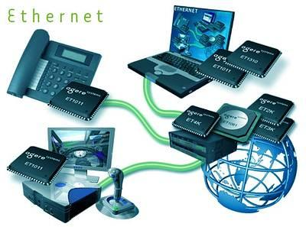
The Internet
- 1-place from computers throughout the world exchange of information and issue dates possibility, lines the system. Internet - communication bees uniting, set of nodes.

Slide 18

Internet profit to be history
1957 year The Council Union Lands artificial satellites' ұшырғаннан after, USA Defense Ministry informations traffic reliable the system necessary 1) decided:. USA advanced research projects' (Barley) for the purpose network proposed.

Slide 19
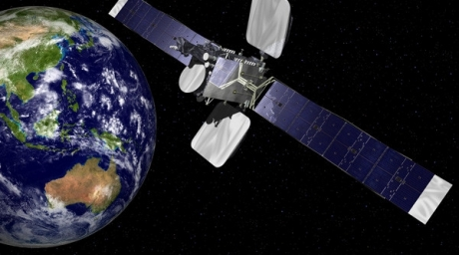
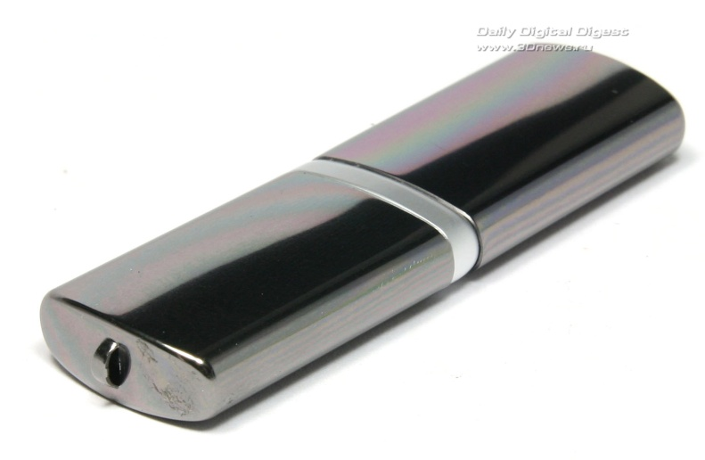
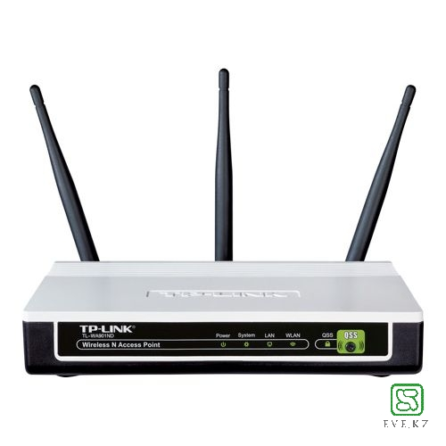
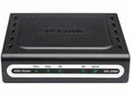
Ways of connecting to the Internet
Radio channel
The satellite channel
Phone channel

Slide 20

In the Internet two basic protocol address applies:
IP address (English. Internet Protocol address) - Internet protocol address this is for every tool (computer, printer and etc.) individual 1. approve plate, this tool a computer in the network rapport for The Internet protocol's applies.
IN THE RNP (Transmission Control Protocol - SR) TCP protocol several application program one on the computer one 2)". usage it is for addresses I ports they must be presented as a collection. Because the ports ID TCP protocol's each software independent таңдалғандықтан, they unique will be;

Slide 21

Delivery management protocol internetwork protocol
- TCP/IP protocols groups transport level protocol. Computers between communication installations after bytes flow in basic intelligence delivery provision 1. approve:. Applied programs TCP protocol ports (protocol port) through reacts;
1970 years USA Defense Ministry create published, into the network wide most common communication protocol view. UNIX surgery the system structure is included, Internet in the system wide applies. TCP protocol's one part — OSI models transport level, but IP protocol's one part networking level's according to 1).

Slide 22
Internet Network
In the network each computer's 4 from a byte resident From 0 to 255 before - in the range decimal numbers, point dedicated individual IP-address there is.
Address on the right leftward 1) reads: 128.250.33.199
network and internal network user computer address determines
IP-addressable the system computers for comfortable, but human such addresses' remember storage easy not. So that domain title the system (DNS) de - introduced.

