Slide 1



Multimedia Technology
Zhunussova Gulnur-
senior lecturer of the Department of computer modeling and
information technologies

Slide 2
Questions:
What is multimedia technology?
Categorization
Major characteristics
History of the term
Word usage and context
Creative industries: Commercial uses, Entertainment and fine arts, Education

Slide 3
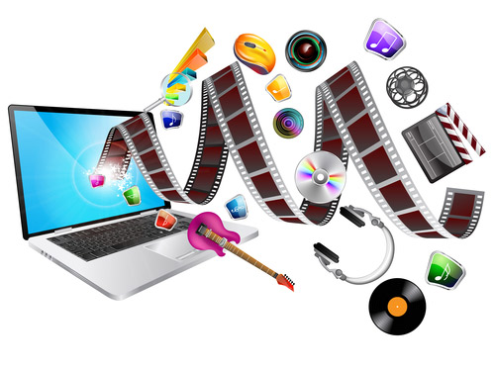
Multimedia is content that uses a combination of different content forms such as text, audio, images, animations, video and interactive content. Multimedia contrasts with media that use only rudimentary computer displays such as text-only or traditional forms of printed or hand-produced material.

Slide 4
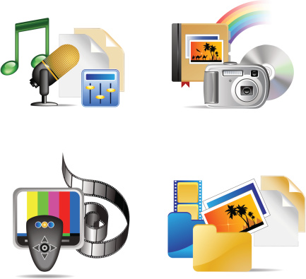
Multimedia can be recorded and played, displayed, interacted with or accessed by information content processing devices, such as computerized and electronic devices, but can also be part of a live performance. Multimedia devices are electronic media devices used to store and experience multimedia content. Multimedia is distinguished from mixed media in fine art; by including audio, for example, it has a broader scope. The term "rich media" is synonymous for interactive multimedia. Hypermedia scales up the amount of media content in multimedia application.

Slide 5
Multimedia may be broadly divided into linear and non-linear categories:
Linear active content progresses often without any navigational control for the viewer such as a cinema presentation;
Non-linear uses interactivity to control progress as with a video game or self-paced computer-based training. Hypermedia is an example of non-linear content.
Multimedia presentations can be live or recorded:
A recorded presentation may allow interactivity via a navigation system;
A live multimedia presentation may allow interactivity via an interaction with the presenter or performer.

Slide 6
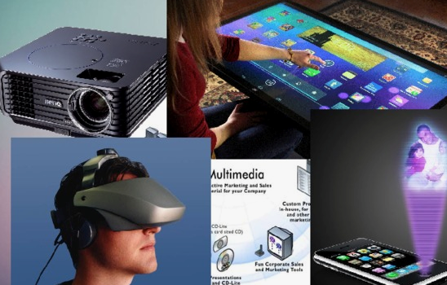
Multimedia presentations may be viewed by person on stage, projected, transmitted, or played locally with a media player. A broadcast may be a live or recorded multimedia presentation. Broadcasts and recordings can be either analog or digital electronic media technology. Digital online multimedia may be downloaded or streamed. Streaming multimedia may be live or on-demand.

Slide 7
Multimedia games and simulations may be used in a physical environment with special effects, with multiple users in an online network, or locally with an offline computer, game system, or simulator.
The various formats of technological or digital multimedia may be intended to enhance the users' experience, for example to make it easier and faster to convey information. Or in entertainment or art, to transcend everyday experience.

Slide 8
Enhanced levels of interactivity are made possible by combining multiple forms of media content. Online multimedia is increasingly becoming object-oriented and data-driven, enabling applications with collaborative end-user innovation and personalization on multiple forms of content over time. Examples of these range from multiple forms of content on Web sites like photo galleries with both images (pictures) and title (text) user-updated, to simulations whose co-efficients, events, illustrations, animations or videos are modifiable, allowing the multimedia "experience" to be altered without reprogramming. In addition to seeing and hearing, haptic technology enables virtual objects to be felt. Emerging technology involving illusions of taste and smell may also enhance the multimedia experience.

Slide 9
History of the term
The term multimedia was coined by singer and artist Bob Goldstein (later 'Bobb Goldsteinn') to promote the July 1966 opening of his "LightWorks at L'Oursin" show at Southampton, Long Island. Goldstein was perhaps aware of an American artist named Dick Higgins, who had two years previously discussed a new approach to art-making he called "intermedia" .

Slide 10
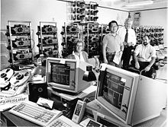
On August 10, 1966, Richard Albarino of Variety borrowed the terminology, reporting: "Brainchild of songscribe-comic Bob ('Washington Square') Goldstein, the 'Lightworks' is the latest multi-media music-cum-visuals to debut as discothèque fare." Two years later, in 1968, the term "multimedia" was re-appropriated to describe the work of a political consultant, David Sawyer, the husband of Iris Sawyer—one of Goldstein's producers at L'Oursin.

Slide 11
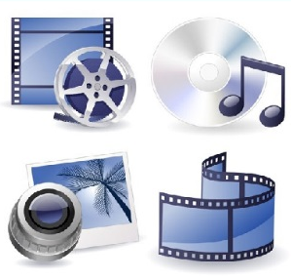
In the intervening forty years, the word has taken on different meanings. In the late 1970s, the term referred to presentations consisting of multi-projector slide shows timed to an audio track. However, by the 1990s 'multimedia' took on its current meaning.
In the 1993 first edition of McGraw-Hill's Multimedia: Making It Work, Tay Vaughan declared "Multimedia is any combination of text, graphic art, sound, animation, and video that is delivered by computer. When you allow the user – the viewer of the project – to control what and when these elements are delivered, it is interactive multimedia. When you provide a structure of linked elements through which the user can navigate, interactive multimedia becomes hypermedia.

Slide 12
The German language society, Gesellschaft für deutsche Sprache, decided to recognize the word's significance and ubiquitousness in the 1990s by awarding it the title of 'Word of the Year' in 1995. The institute summed up its rationale by stating "[Multimedia] has become a central word in the wonderful new media world".
In common usage, multimedia refers to an electronically delivered combination of media including video, still images, audio, text in such a way that can be accessed interactively. Much of the content on the web today falls within this definition as understood by millions. Some computers which were marketed in the 1990s were called "multimedia" computers because they incorporated a CD-ROM drive, which allowed for the delivery of several hundred megabytes of video, picture, and audio data. That era saw also a boost in the production of educational multimedia CD-ROMs.

Slide 13
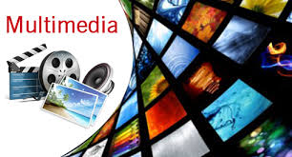
Word usage and context
Since media is the plural of medium, the term "multimedia" is used to describe multiple occurrences of only one form of media such as a collection of audio CDs. This is why it's important that the word "multimedia" is used exclusively to describe multiple forms of media and content.

Slide 14

The term "multimedia" is also ambiguous. Static content (such as a paper book) may be considered multimedia if it contains both pictures and text or may be considered interactive if the user interacts by turning pages at will. Books may also be considered non-linear if the pages are accessed non-sequentially. The term "video", if not used exclusively to describe motion photography, is ambiguous in multimedia terminology. Video is often used to describe the file format, delivery format, or presentation format instead of "footage" which is used to distinguish motion photography from "animation" of rendered motion imagery.

Slide 15
Multiple forms of information content are often not considered modern forms of presentation such as audio or video. Likewise, single forms of information content with single methods of information processing (e.g. non-interactive audio) are often called multimedia, perhaps to distinguish static media from active media. In the Fine arts, for example, Leda Luss Luyken's ModulArt brings two key elements of musical composition and film into the world of painting: variation of a theme and movement of and within a picture, making ModulArt an interactive multimedia form of art. Performing arts may also be considered multimedia considering that performers and props are multiple forms of both content and media.

Slide 16
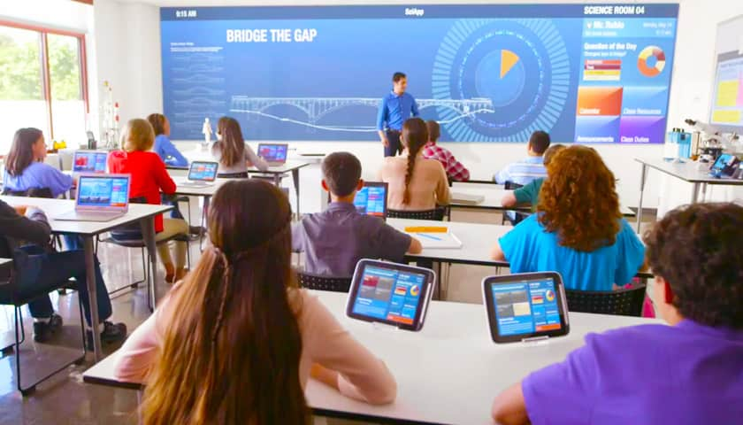


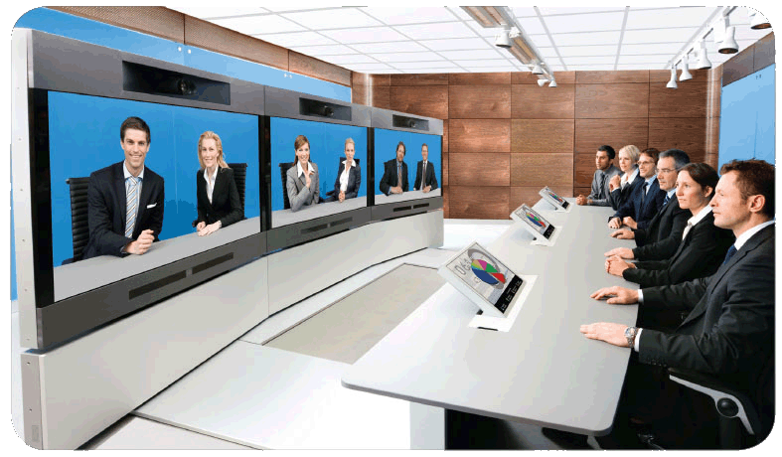
Multimedia finds its application in various areas including, but not limited to, advertisements, art, education, entertainment, engineering, medicine, mathematics, business, scientific research and spatial temporal applications. Several examples are as follows:
Creative industries
Creative industries use multimedia for a variety of purposes ranging from fine arts, to entertainment, to commercial art, to journalism, to media and software services provided for any of the industries listed below. An individual multimedia designer may cover the spectrum throughout their career. Request for their skills range from technical, to analytical, to creative.

Slide 17
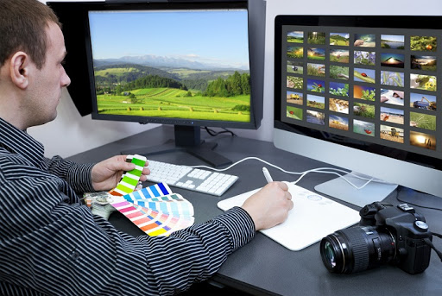
Commercial uses
Much of the electronic old and new media used by commercial artists and graphic designers is multimedia. Exciting presentations are used to grab and keep attention in advertising. Business to business, and interoffice communications are often developed by creative services firms for advanced multimedia presentations beyond simple slide shows to sell ideas or liven-up training.
Commercial multimedia developers may be hired to design for governmental services and nonprofit services applications as well.

Slide 18

Entertainment and fine arts
In addition, multimedia is heavily used in the entertainment industry, especially to develop special effects in movies and animations (VFX, 3D animation, etc.). Multimedia games are a popular pastime and are software programs available either as CD-ROMs or online. Some video games also use multimedia features. Multimedia applications that allow users to actively participate instead of just sitting by as passive recipients of information are called Interactive Multimedia.

Slide 19

In the Arts there are multimedia artists, whose minds are able to blend techniques using different media that in some way incorporates interaction with the viewer. One of the most relevant could be Peter Greenaway who is melding Cinema with Opera and all sorts of digital media. Another approach entails the creation of multimedia that can be displayed in a traditional fine arts arena, such as an art gallery. Although multimedia display material may be volatile, the survivability of the content is as strong as any traditional media. Digital recording material may be just as durable and infinitely reproducible with perfect copies every time.

Slide 20
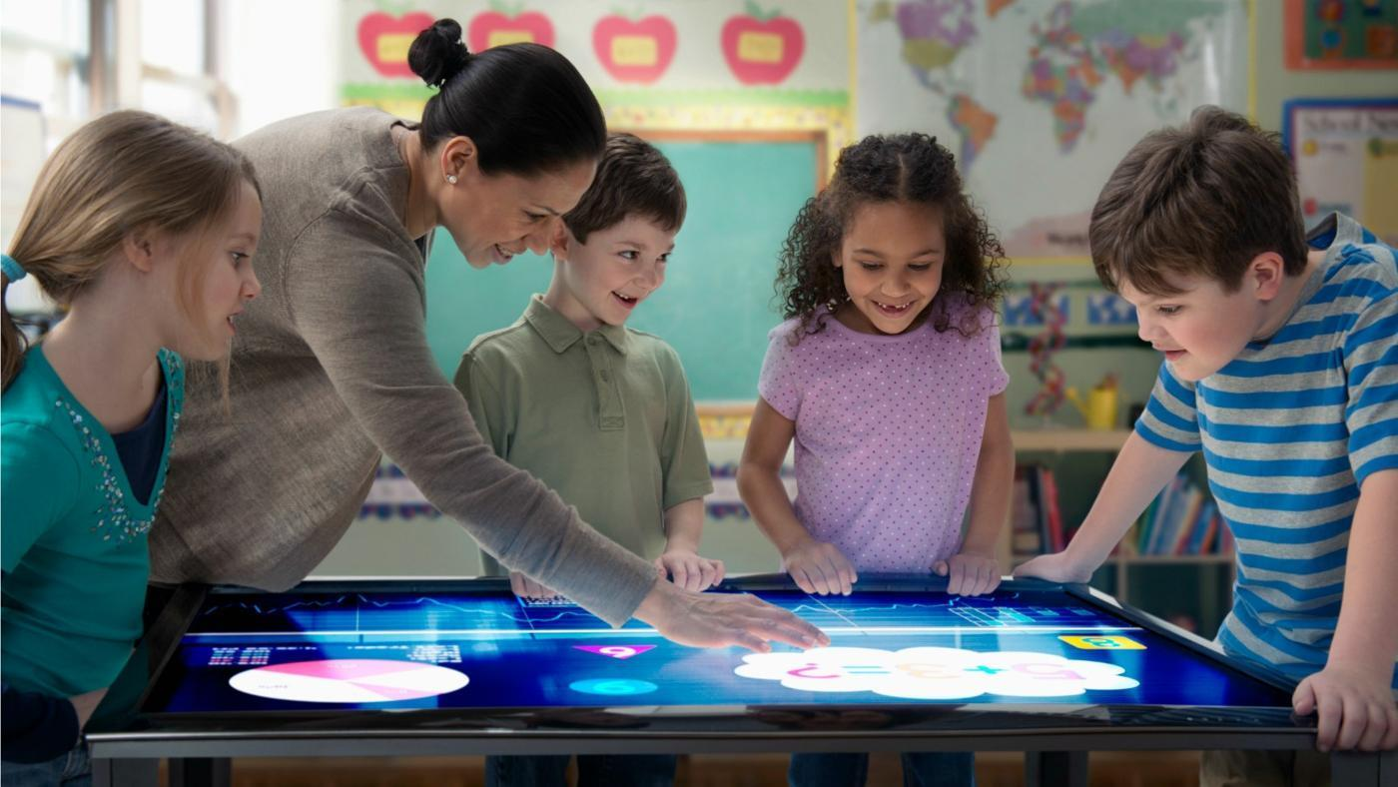
Education
In education, multimedia is used to produce computer-based training courses (popularly called CBTs) and reference books like encyclopedia and almanacs. A CBT lets the user go through a series of presentations, text about a particular topic, and associated illustrations in various information formats. Edutainment is the combination of education with entertainment, especially multimedia entertainment.
Learning theory in the past decade has expanded dramatically because of the introduction of multimedia. Several lines of research have evolved (e.g. Cognitive load, Multimedia learning, etc.). The possibilities for learning and instruction are nearly endless.

Slide 21
From Multimedia Learning (MML) theory, David Roberts has developed a large group lecture practice using PowerPoint and based on the use of full-slide images in conjunction with a reduction of visible text (all text can be placed in the notes view’ section of PowerPoint). The method has been applied and evaluated in 9 disciplines. In each experiment, students’ engagement and active learning has been approximately 66% greater, than with the same material being delivered using bullet points, text and speech, corroborating a range of theories presented by multimedia learning scholars like Sweller and Mayer. The idea of media convergence is also becoming a major factor in education, particularly higher education.

Slide 22

Defined as separate technologies such as voice (and telephony features), data (and productivity applications) and video that now share resources and interact with each other, media convergence is rapidly changing the curriculum in universities all over the world. Likewise, it is changing the availability, or lack thereof, of jobs requiring this savvy technological skill.

